Slide 1
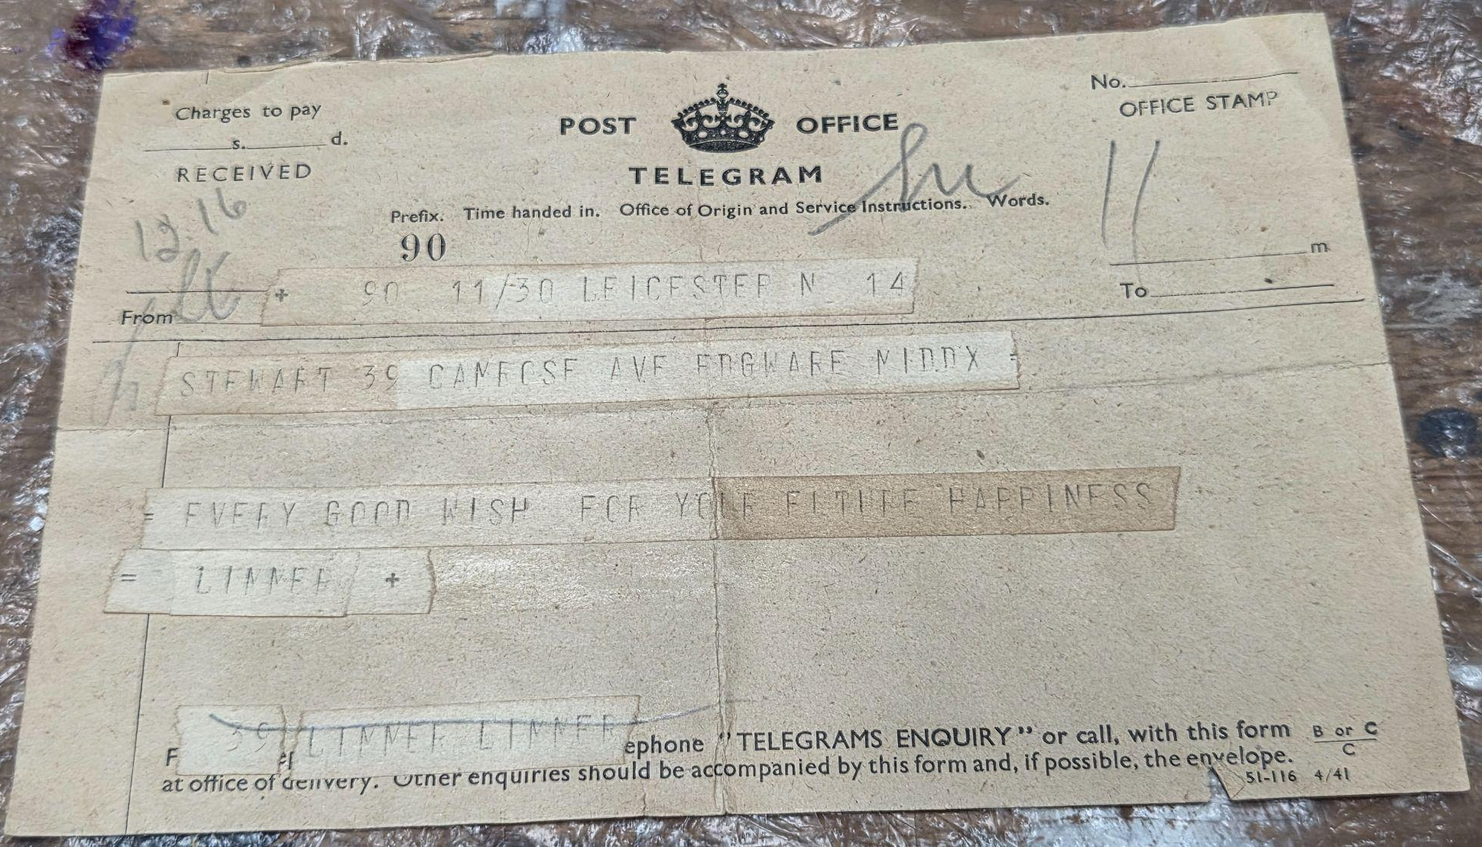
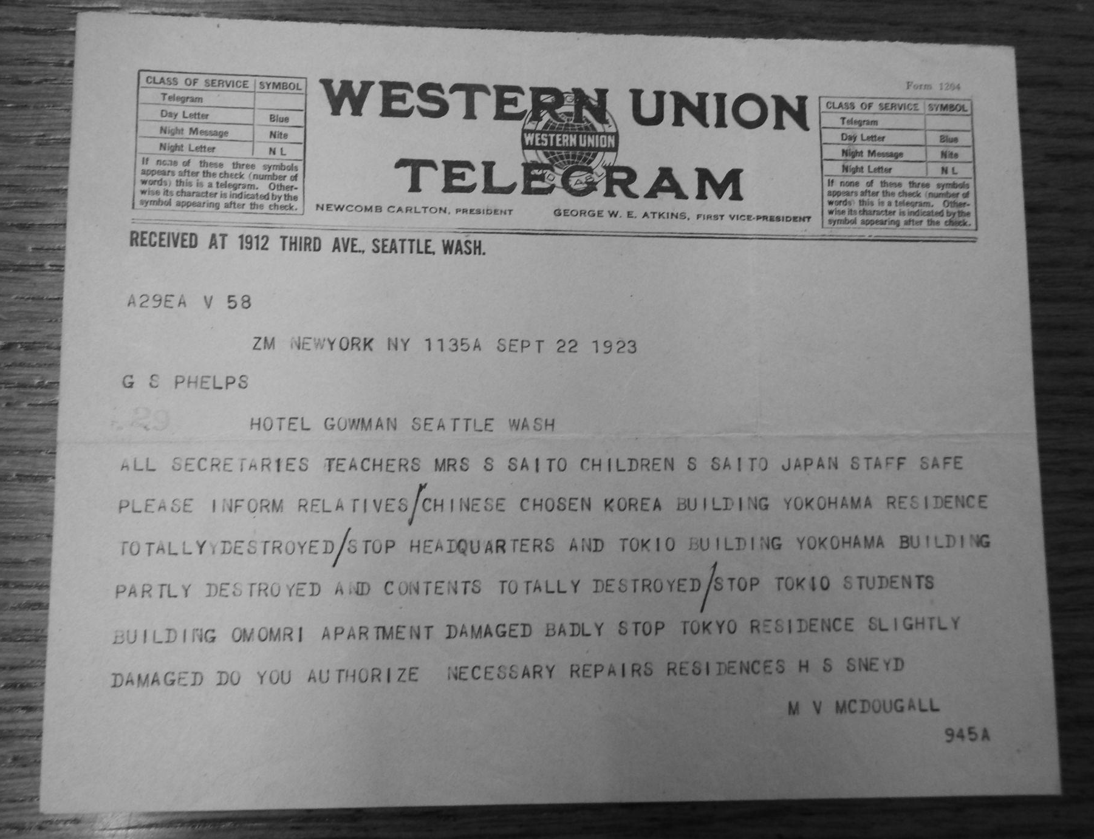
Short and Sweet:
using haiku “telegrams”
to revisit family history
family photos
Jessica Allyson
Haiku Canada Weekend
May 16, 2026
Notes:
SLIDE 1:
Good afternoon, everyone, bonjour à tous. It’s a pleasure to be here this afternoon.

Slide 2
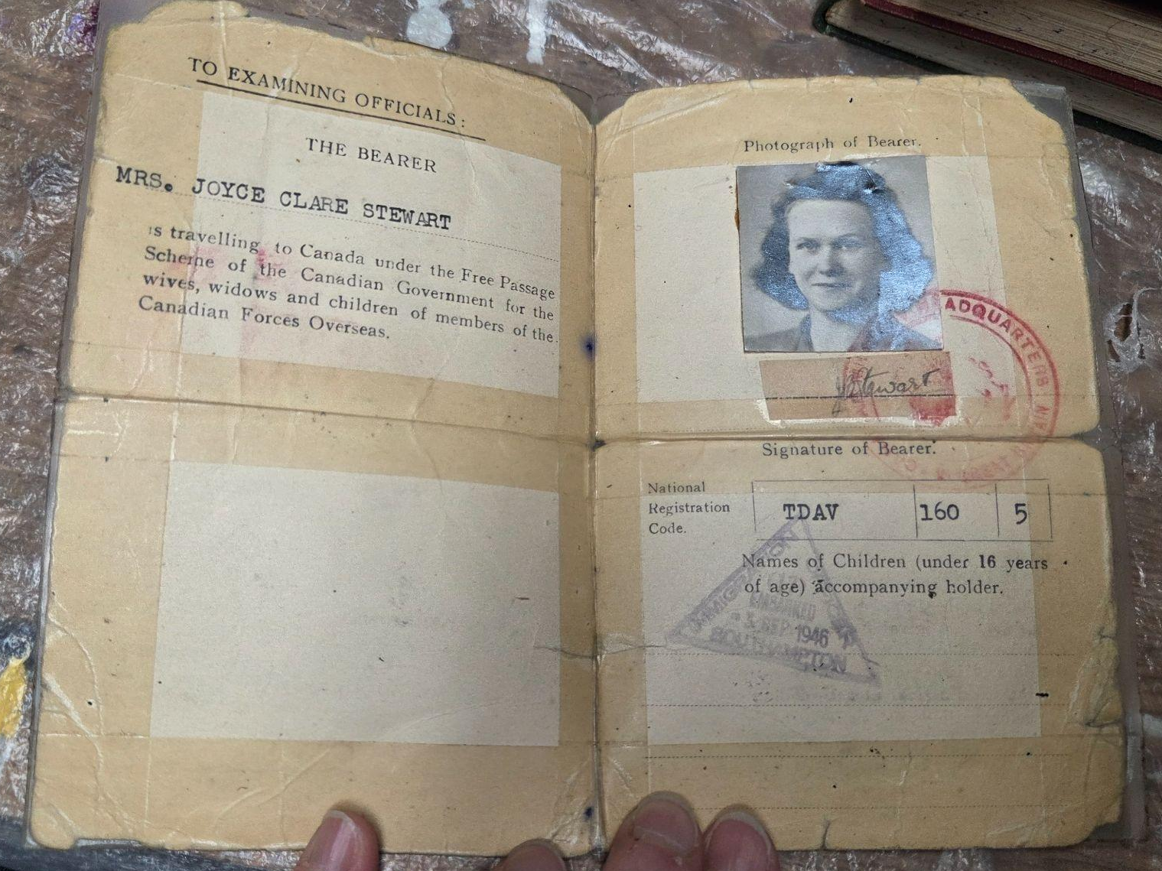
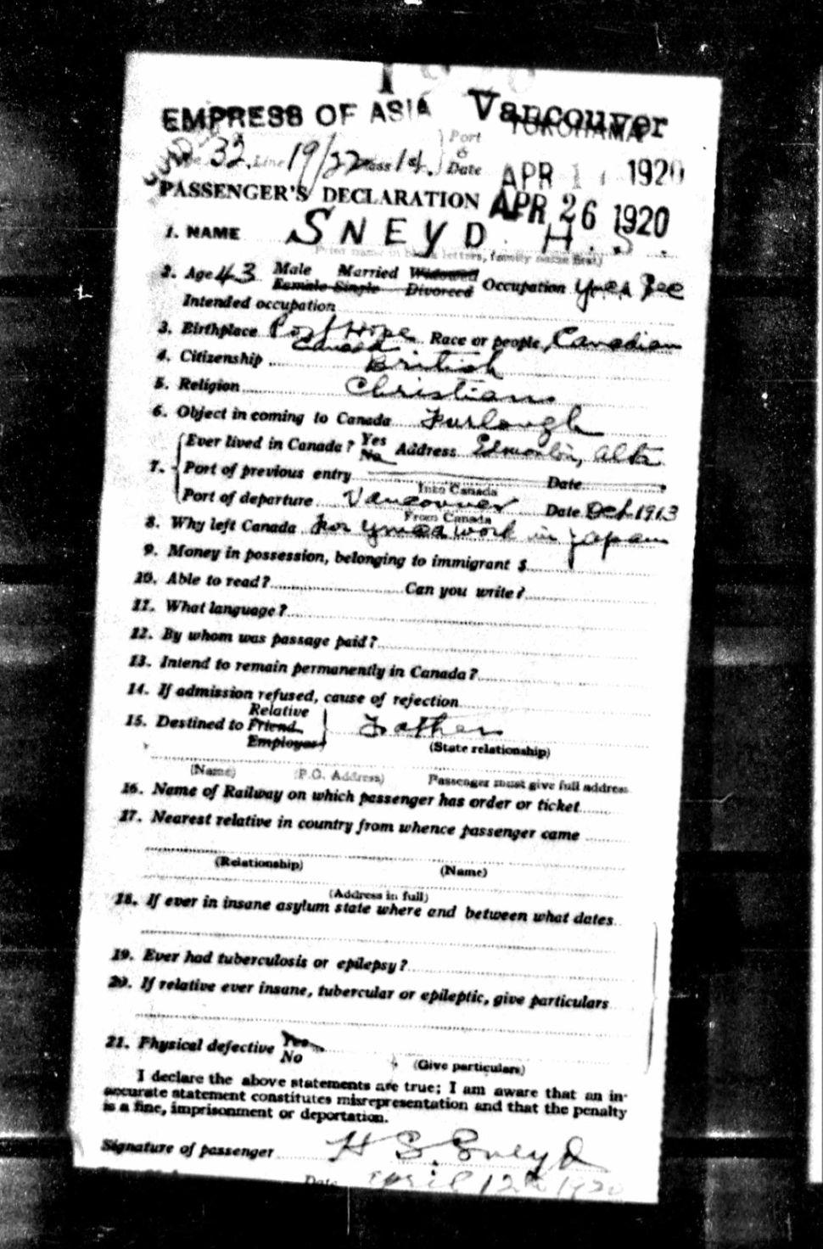
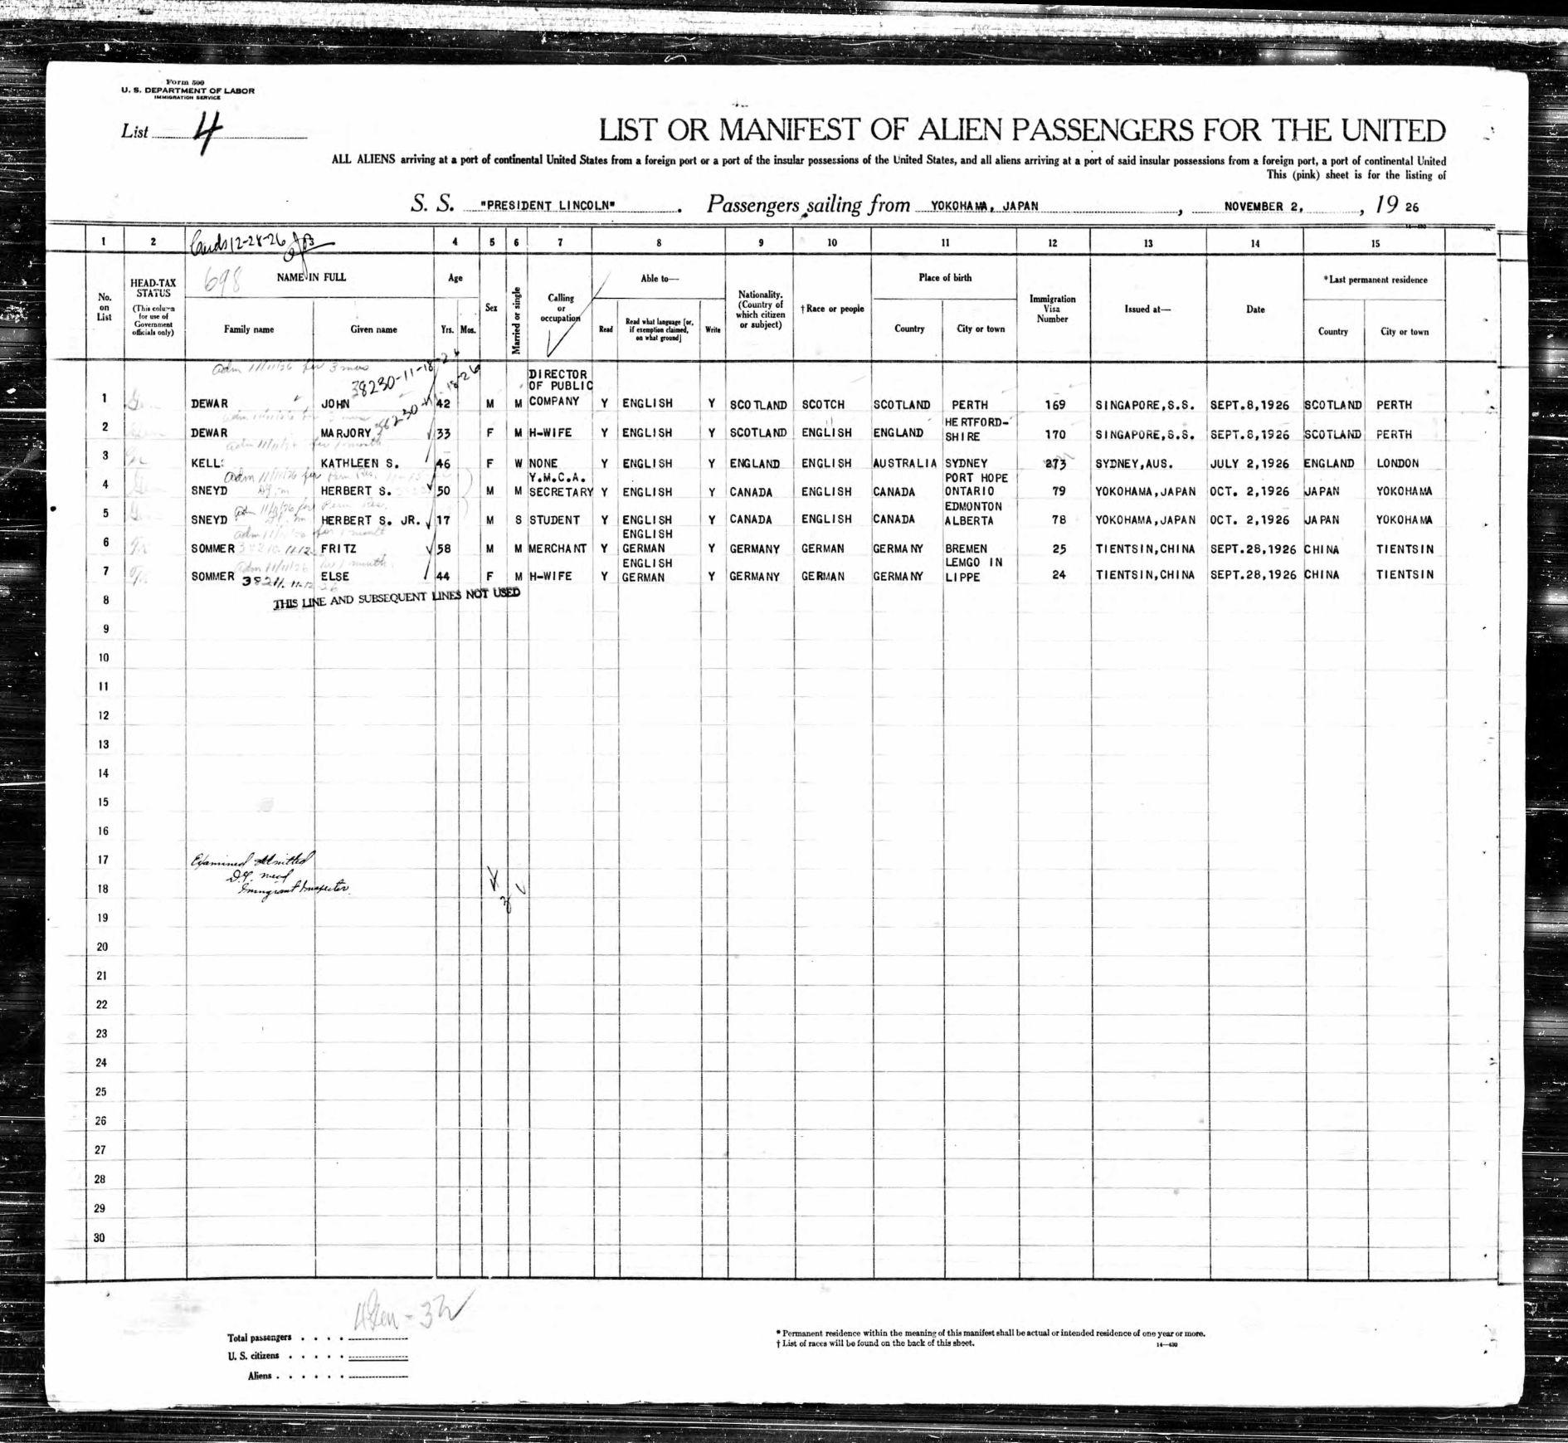
Joyce came to Canada in 1946
family photo
Stan crossed the Pacific 6 times between the ages of 4 and 17…
www.ancestry.ca
Notes:
SLIDE 2
When the topic of immigration/migration was first announced for this Haiku Canada Weekend, I wasn’t sure that I had anything meaningful to contribute, having lived in Ontario for nearly all of my life. But when I thought about it, I remembered that my maternal grandmother, Joyce Stewart, was an English War Bride, so there was certainly material there. Then I thought further and realized that my paternal grandfather, Stan Sneyd, lived a pretty itinerant life. Born in Edmonton, he lived in various places, including Yokohama, until he settled in Hamilton, Ontario, so he fit the bill too.

Slide 3
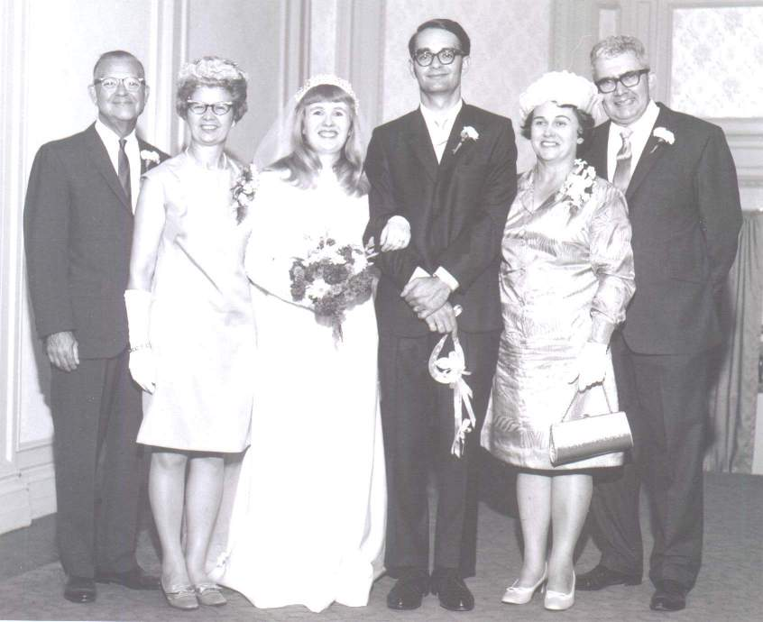
Mildred Sneyd
1918-2016
Joyce Stewart
1924-1970
Herbert Stanley
Sneyd Jr.
1909-1977
Arthur Stewart
1922-2011
family photo
Clare Stewart & Carl Sneyd
married August 22, 1969
Notes:
SLIDE 3
I’ve long been interested in my grandparents’ stories. Here are all four of them at their children’s wedding. I’m fortunate that two of my grandparents, Mildred Sneyd and Arthur Stewart, lived very long lives and left us memoirs of their respective experiences as a schoolteacher and a Canadian soldier.

Slide 4
Mildred Sneyd
1918-2016
Joyce Stewart
1924-1970
Herbert Stanley
Sneyd Jr.
1909-1977
Arthur Stewart
1922-2011
family photo
Clare Stewart & Carl Sneyd
married August 22, 1969
Notes:
SLIDE 4
Unfortunately, we didn’t have the same luxury of time with either Stan or Joyce. Joyce died when she was only 45, in February 1970, a few months after my parents were married. Stan died of a heart attack in January 1977 at the age of 67. I didn’t come along until December of that year, so we never knew each other.

Slide 5
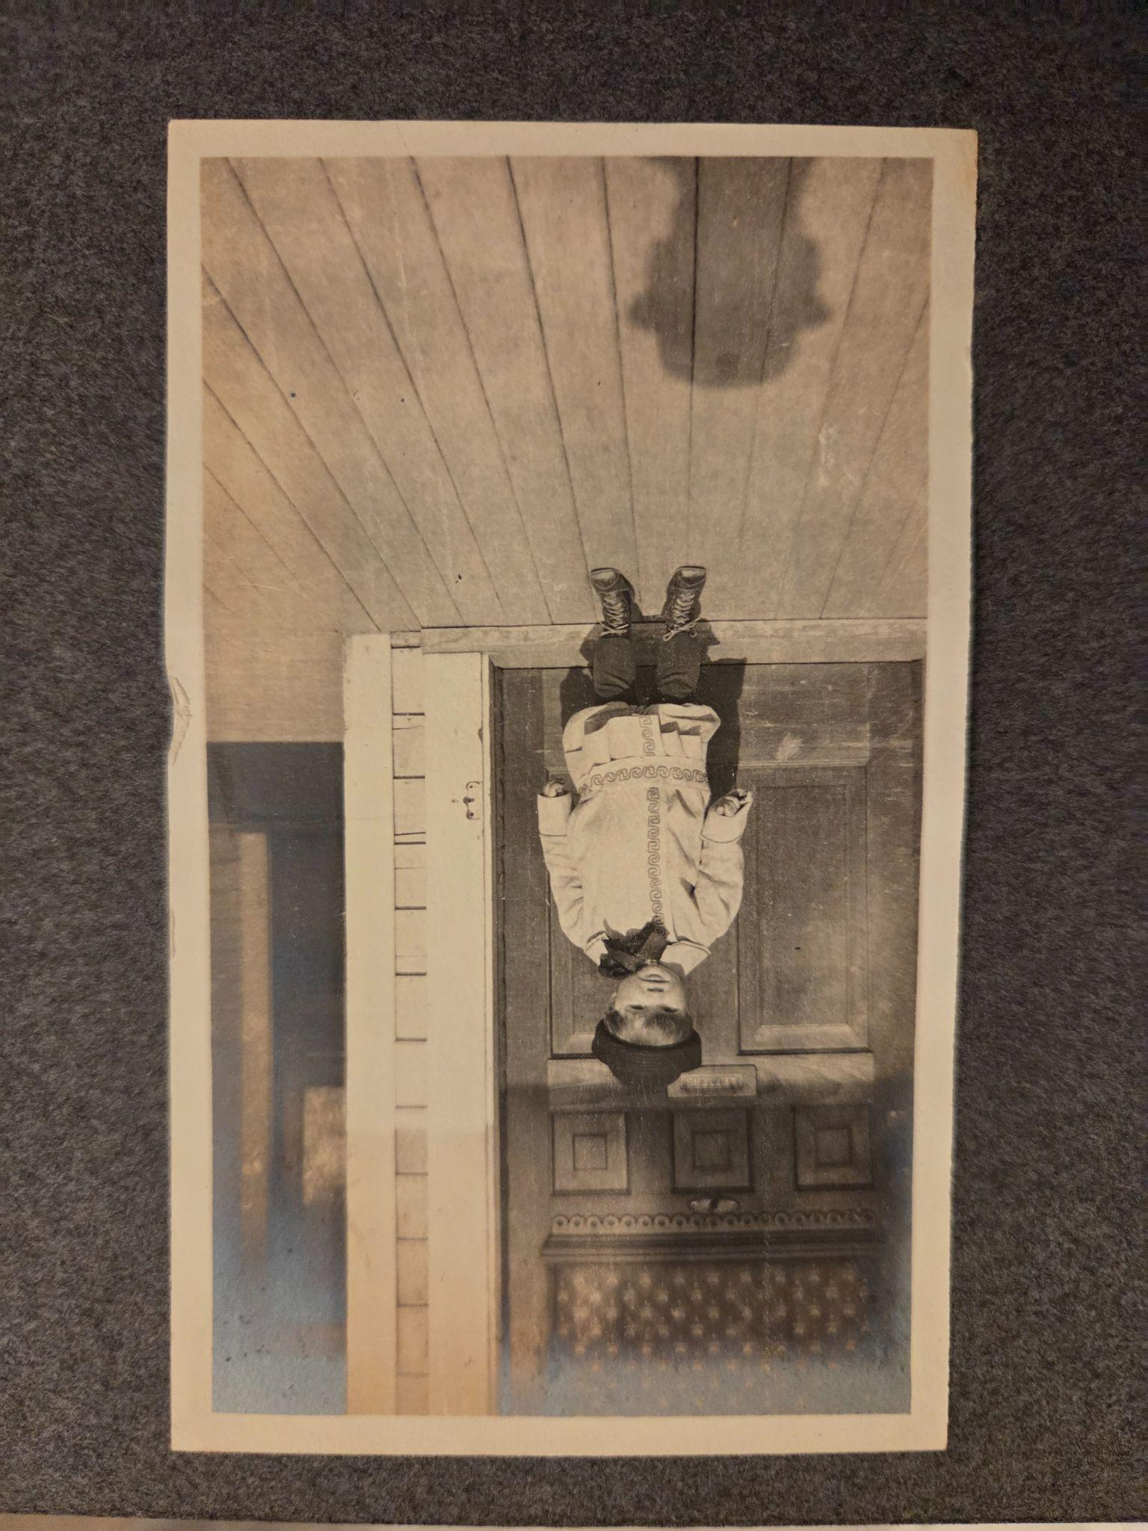
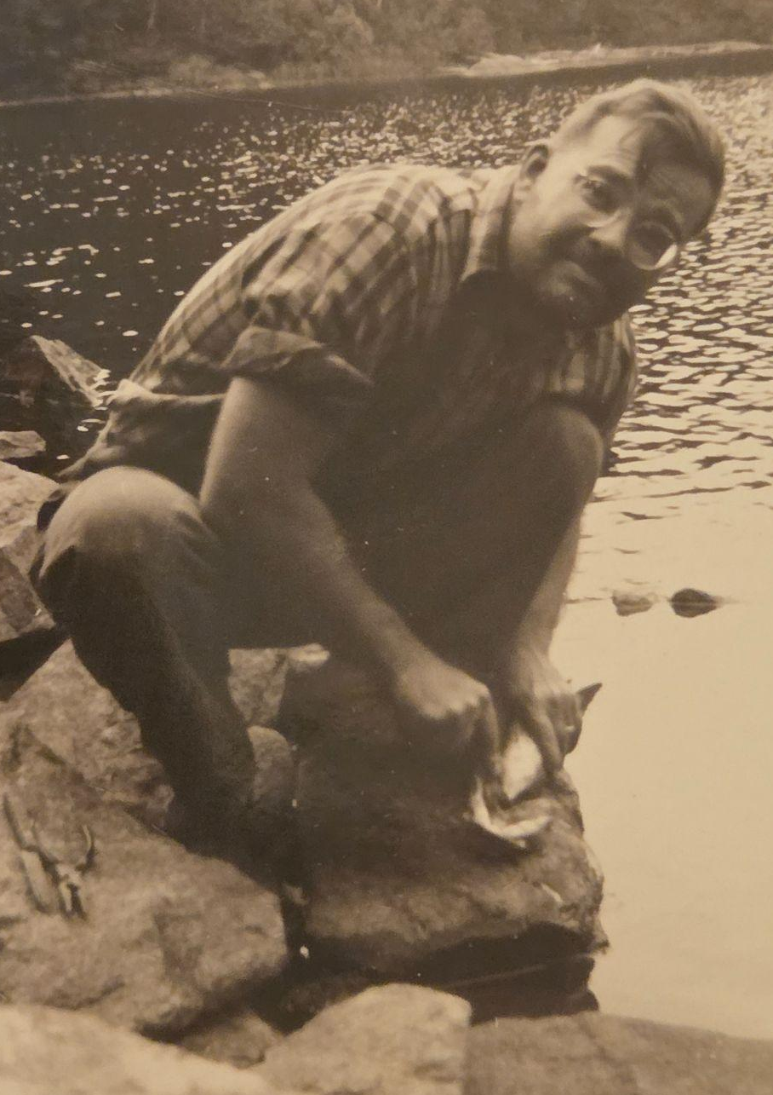
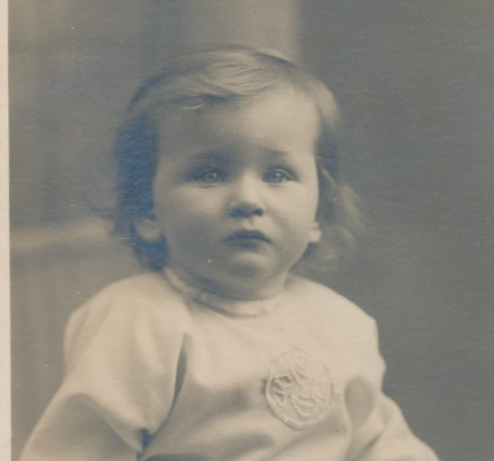
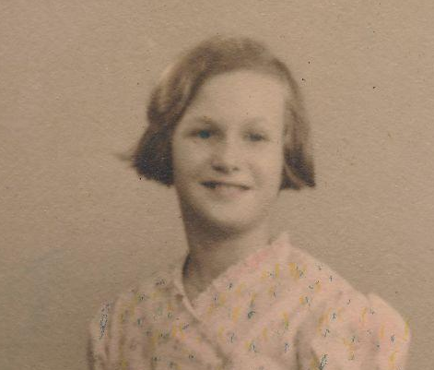
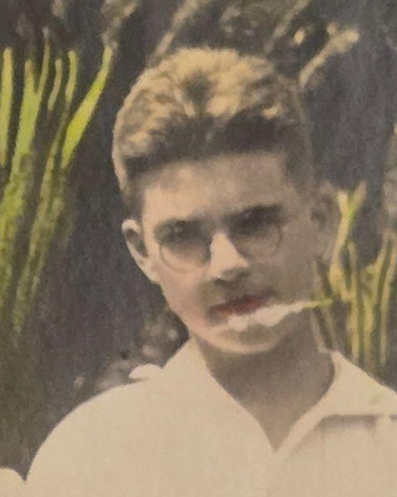
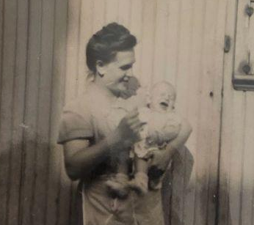
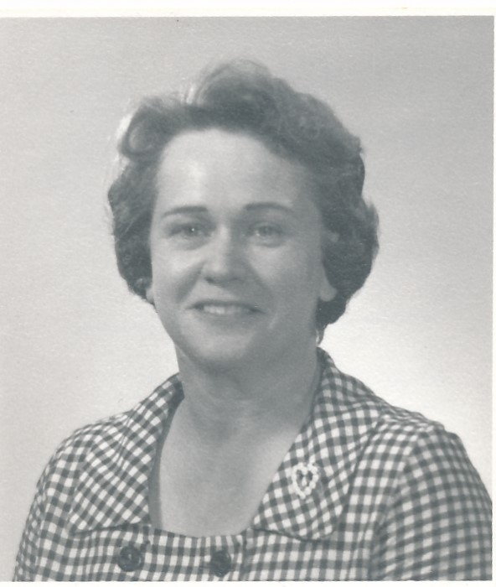
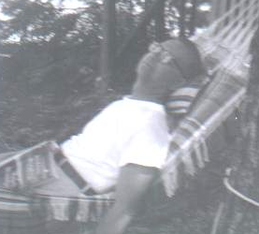
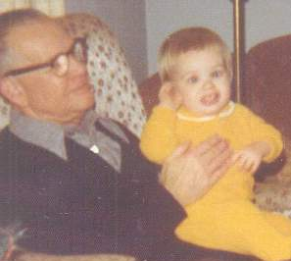
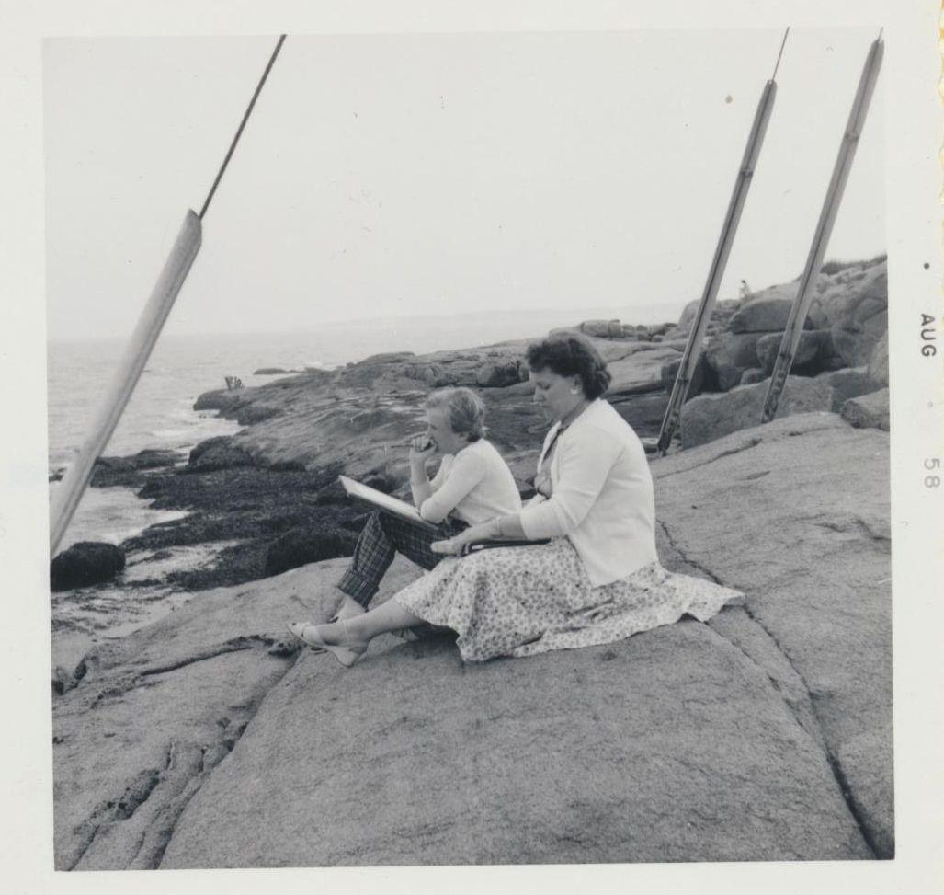
family photos
Notes:
SLIDE 4
As I was working on this project, I was surprised to realize that despite their difference in age and backgrounds, Stan and Joyce had a number of things in common. He was a Boy Scout in Japan, she was a Girl Guide in England. When they were young they both enjoyed performing. They both came from large extended families, but their immediate families were quite small. They both suffered a major loss at a young age. They both survived major world events. And, once they made their respective moves to Hamilton, they settled there for life. Stan never returned to Japan and Joyce never returned to England.

Slide 6
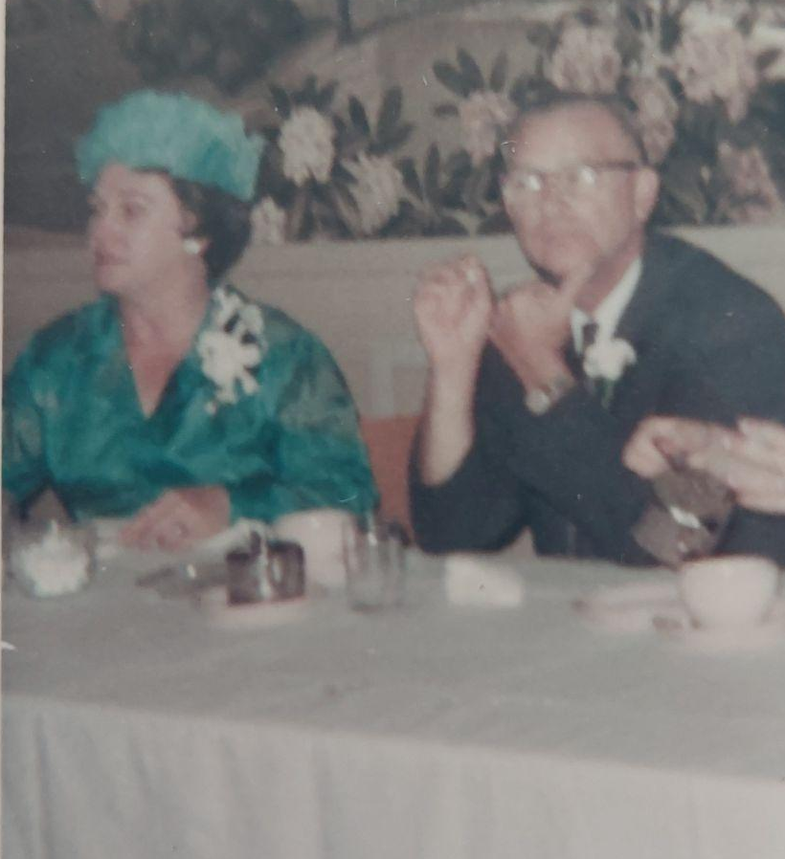
freshly blended
the only picture I have
of you together
family photo
Notes:
SLIDE 6
This is the only picture I have of Joyce and Stan. It was taken when they were sitting at the head table for Clare and Carl’s wedding reception and inspired the following haiku:
freshly blended
the only picture I have
of you together
How do you capture the life of someone you’ve known about all your life but you’ve never actually known? When all you have are former possessions, faded documents, or shards poking out of other people’s memories? Where do you even start to pull the pieces together? How do you make sense of it all? I think these are questions we’ve all grappled with at one point or another in our lives. These are all questions I faced while working on this project. Haiku, it turns out, was part of the answer.

Slide 7
haiku
.... .- .. -.- ..-
Notes:
[SLIDE 7]
Now, Stan spoke Japanese fairly well (he earned his translation merit badge when in Scouts), so haiku seems a natural fit for writing about his life. In the name of full disclosure, I should point out that his parents worked for the YMCA at a time when the C certainly meant “Christian”. I don’t really have time in this presentation to get into the history of Christianity in Japan, except to say that in the first half of the 20th century, the Japanese ruling class kept a close eye on organizations like the Y. As a result, Christianity was never a key part of Westernization in Japan as it has been in other countries. I keep this in the back of my mind when I write, so that I approach the style with appreciation, not appropriation. Certainly, if I eventually write about my family’s role in assisting with the resettlement of Japanese-Canadians during and after the Second World War, I would tread very carefully indeed.
So far as I know, Joyce had no personal connection with Japan aside from Japanese goods she may have encountered while growing up in interwar London.
Even so, the nature of haiku as a poem of elusive moments and of wabi-sabi makes it well suited for writing about her life as well.

Slide 8
telegrams
- . .-.. . --. .-. .- -- ...
Notes:
[SLIDE 8]
Regardless, both Stan and Joyce were very familiar with another form of communication that said a lot in very few words. I mean, of course, the telegram. For much of my grandparents’ lives, telegrams were one of the fastest and cheapest ways to communicate across great distances. We’re fortunate to have copies of telegrams that relate directly to my grandparents.

Slide 9
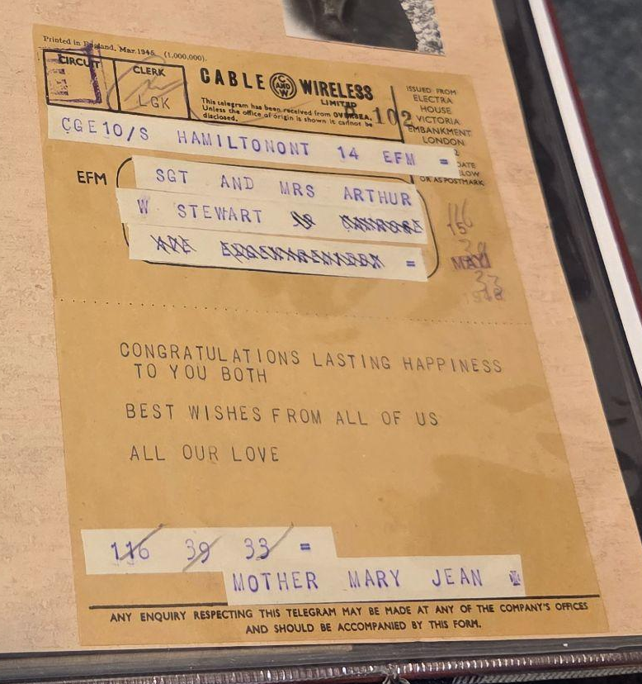
family photo
Notes:
[SLIDE 9]
This telegram was sent by Art’s mother and sisters back in Canada eighty years ago, and says: “CONGRATULATIONS LASTING HAPPINESS TO YOU BOTH BEST WISHES FROM ALL OF US ALL OUR LOVE MOTHER MARY JEAN”. Thanks to my great-grandmother’s diary, we know that this was in response to a telegram Art had sent his mother the day before. In addition, later diary entries show that telegrams were used to communicate key details of both Art and Joyce’s journeys to Canada. The family was using telegrams as late as 1970, one is mentioned in a letter we have from Joyce’s Auntie Bea who references receiving the news of her niece’s death by wire.

Slide 10
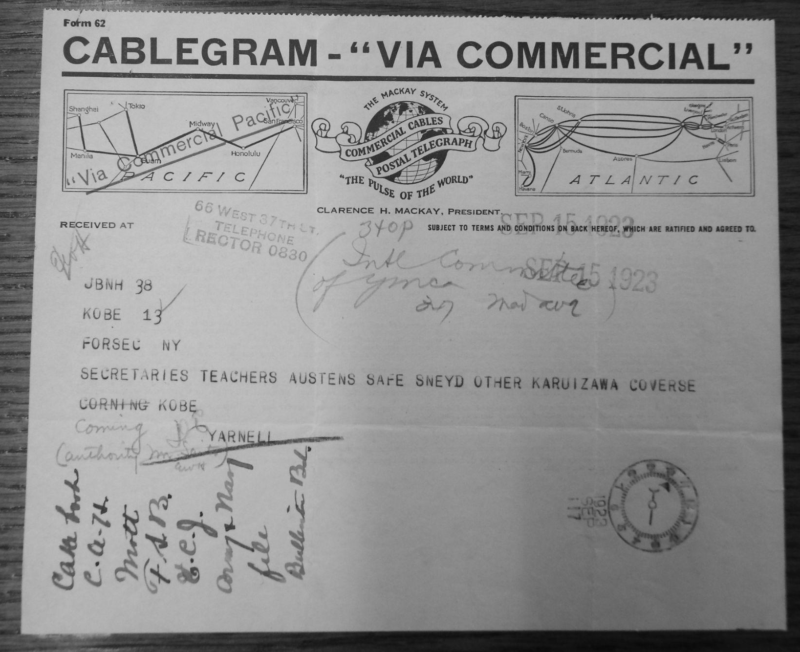
family photo
Notes:
[SLIDE 10]
As for Stan, the few telegrams we have photos of relate to the family’s time in Japan. As a worldwide organization, the Y made great use of telegrams to communicate, particularly with headquarters back in New York. Often, these messages would be encoded for privacy purposes in case of interception, but the translated copies were often filed away. This telegram, which Dad and I found in the Y archives at the University of Minnesota was sent from Kobe to New York after the Great Kanto Earthquake of 1923: “SECRETARIES TEACHERS AUSTENS SAFE SNEYD OTHER KARUIZAWA CONVERSE CORNING KOBE”.
Very prosaic, aren’t they? It highlights a couple of key differences between telegrams and haiku. The former tends to avoid ambiguity, while the latter deals with subtlety. You also don’t tend to find descriptive elements in a telegram unless it’s longer than usual. The catch with telegrams, of course, was that you were charged either by the word or the character, so clarity and conciseness were key, much like haiku. They were messages that were immediate and in the moment, as haiku often are.
And so, I found there’s lots of scope for imagination here, as Anne of Green Gables would say. While they may not adhere completely to Western Union standards, the haiku I’ve generated for this project can be considered telegrams from the past.

Slide 11
challenges
-.-. .... .- .-.. .-.. . -. --. . ...
Notes:
[SLIDE 11]
Before we dive into the various poems, I want to talk about the challenges I’ve faced on this project.
Perhaps the biggest difficulty has been the reality that it’s been nearly 122 years since Stan was born, and nearly 50 since his death. And, similarly, it’s been over 100 years since Joyce was born and over 55 years since her passing. As you can imagine, this impacts my ability to gather information.
My dad sums it up nicely: “there are so many things I’d ask about now that I didn’t think to ask at the time”. I certainly don’t fault either Dad or Mum one bit. I can’t imagine how challenging it was to each lose a parent while they were trying to establish themselves, their home, and their family. And, to their credit, they’ve done their best to share their parents’ stories with me and my brother.
In addition to my parents, the few people I’ve been able to contact who knew Joyce or Stan were quite young at the time. Everyone else has either passed away or the family’s lost touch with them. That being said, I have been able to write some poems based on the memories that were shared with me.

Slide 12
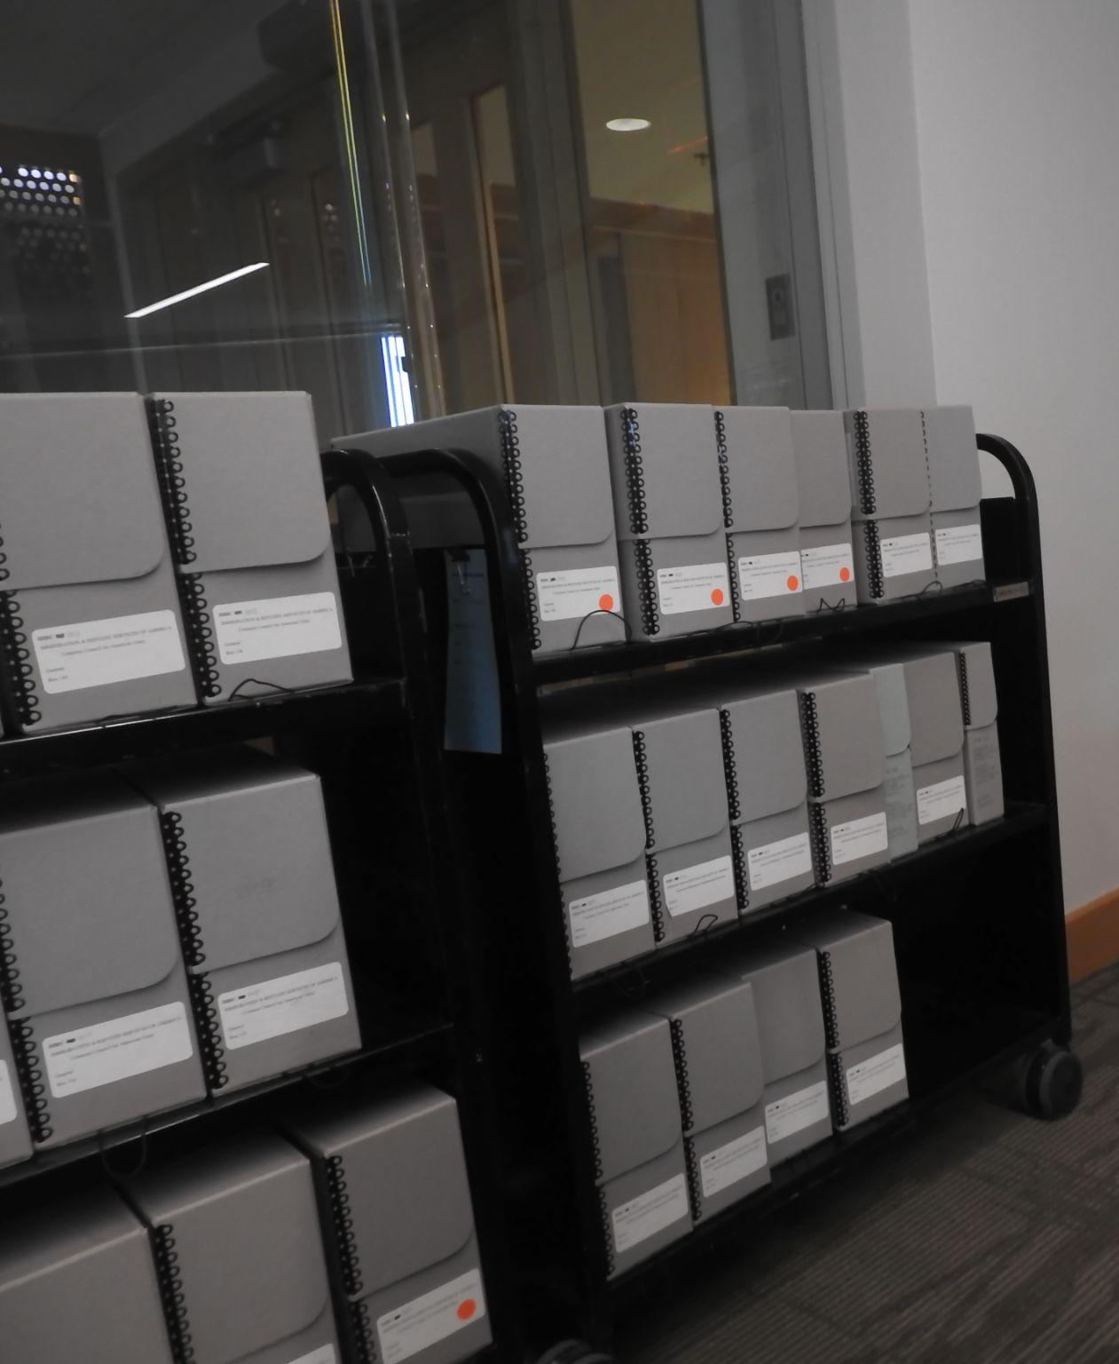
ancestral archives
a jewel beetle
shines in the forest
family photo
Notes:
[SLIDE 12]
Next has been the paper trail. While my parents have a family archive that’s yielded all sorts of interesting information and photos, there’s still a lot that wasn’t kept or has been lost. We’ve been able to fill in some gaps through internet and physical archive searches, but much remains unreachable. This haiku captures the challenge of the search and the joy of finding something unexpected.
ancestral archives
a jewel beetle
shines in the forest

Slide 13
telegrams from the past
- . .-.. . --. .-. .- -- ... / ..-. .-. --- -- / - .... . / .--. .- ... -
Notes:
[SLIDE 13]
The result has been rather like trying to put together a jigsaw puzzle without all the pieces and no instructions. But again, haiku has proved its usefulness in preserving of a memory when you know you’ll never have all the details.
To show you what I mean, here are some haiku I’ve written about them, along with some images that inspired me.

Slide 14
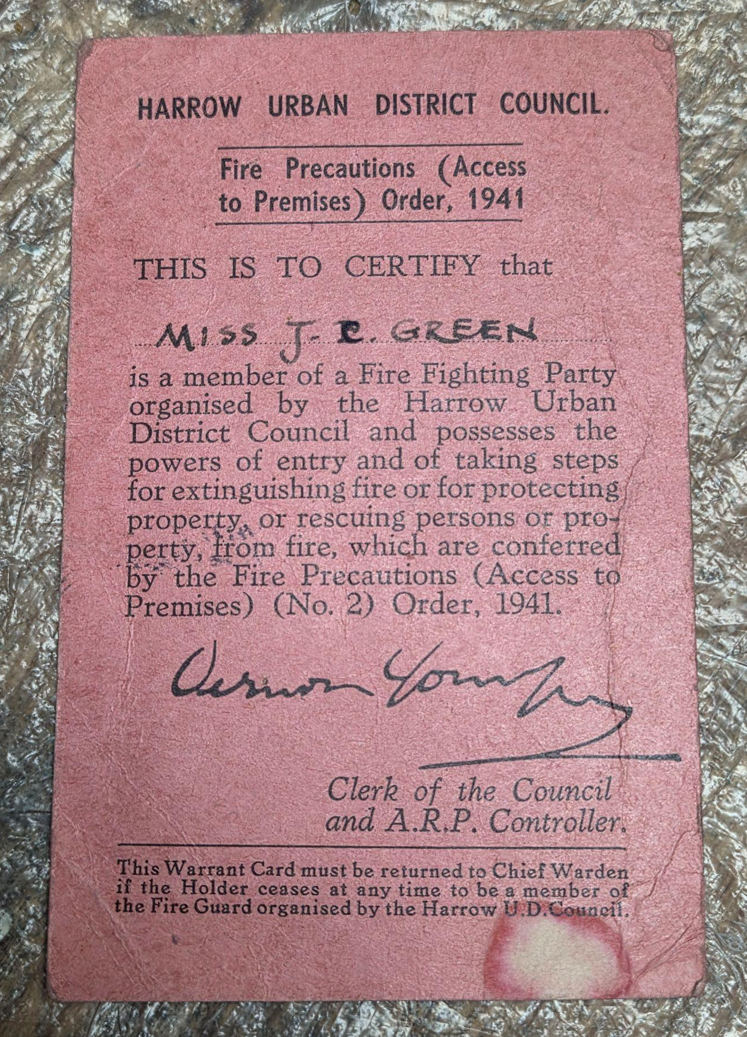
“FIRE WARDEN” armband
and an ID card
what I did in the war
family photo
Notes:
[SLIDE 14]
Joyce was a teenager when the war broke out, but when she was old enough, she signed up to help protect her hometown:
“FIRE WARDEN” armband
and an ID card
what I did in the war

Slide 15
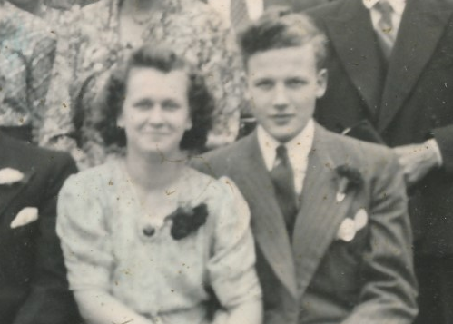
packing away
the silk map he gave you
lost treasure
family photo
Notes:
[SLIDE 15]
She lost her first fiance, Pilot Officer Ivor Morgan when his plane was shot down over France in April 1943. She was 19, he was 22.
packing away
the silk map he gave you
lost treasure

Slide 16
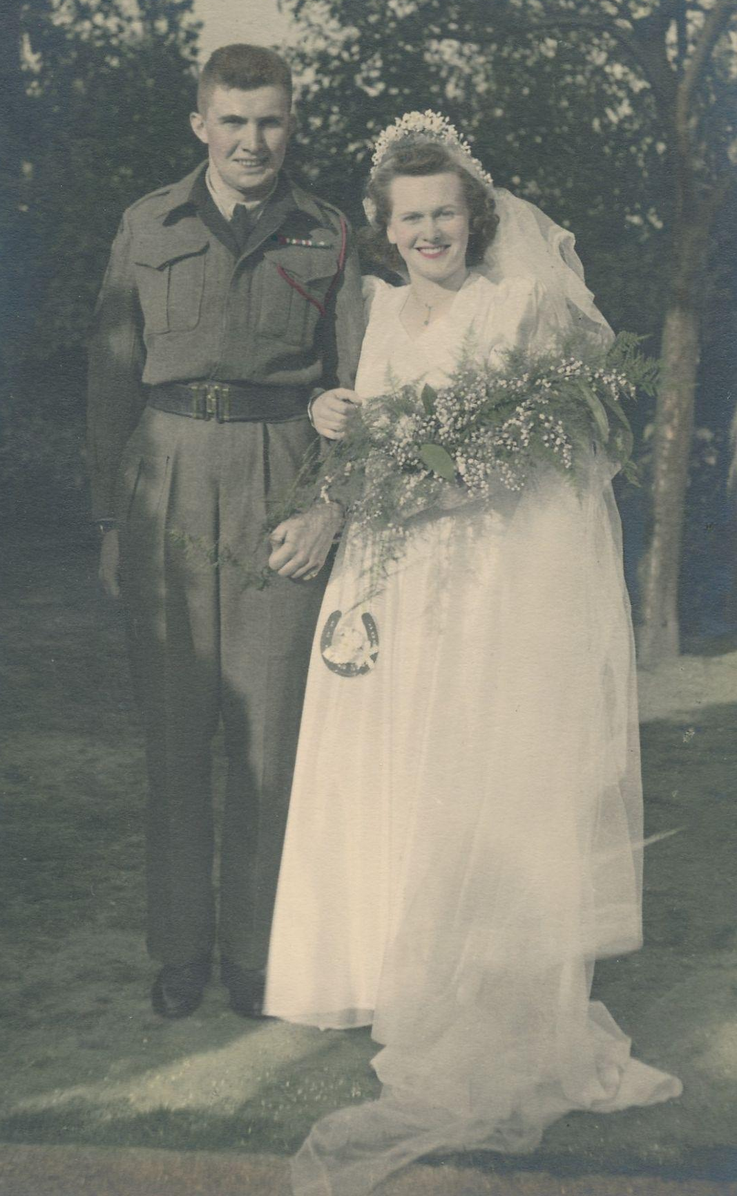
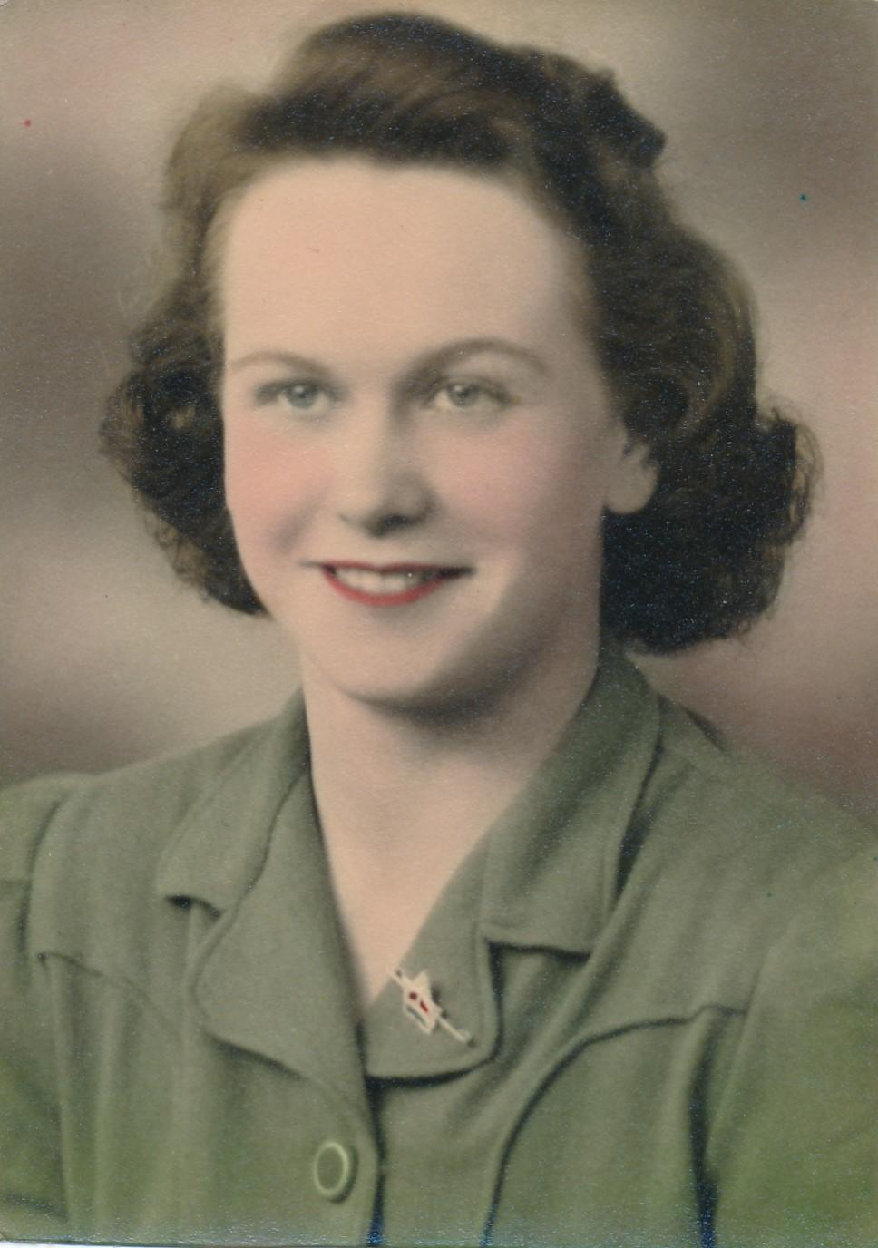
my grandmother’s
silver maple pin
lest I forget
family photos
Notes:
[SLIDE 16]
Soon after, she met Art. They took their time, and became engaged in the fall of 1945:
my grandmother’s
silver maple pin
lest I forget

Slide 17
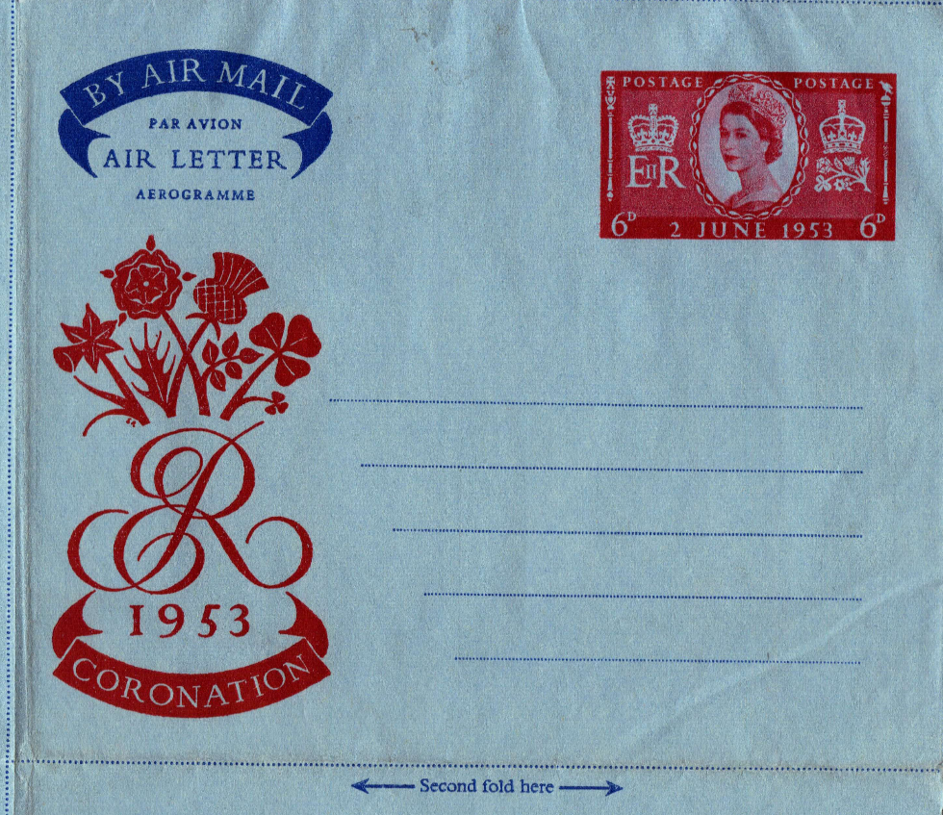
christmas in july
we plan the next hamper
for overseas
out of the blue
an aerogramme arrives
from “home”
https://www.collectgbstamps.co.uk/explore/stationery/aerogrammes/#aerogrammes-2
Notes:
[SLIDE 17]
Shortly before Joyce gave birth to my Mum, her parents migrated to Canada to be with her. But they always kept in close contact with their English family.
christmas in july
we plan the next hamper
for overseas
out of the blue
an aerogram arrives
from “home”

Slide 18
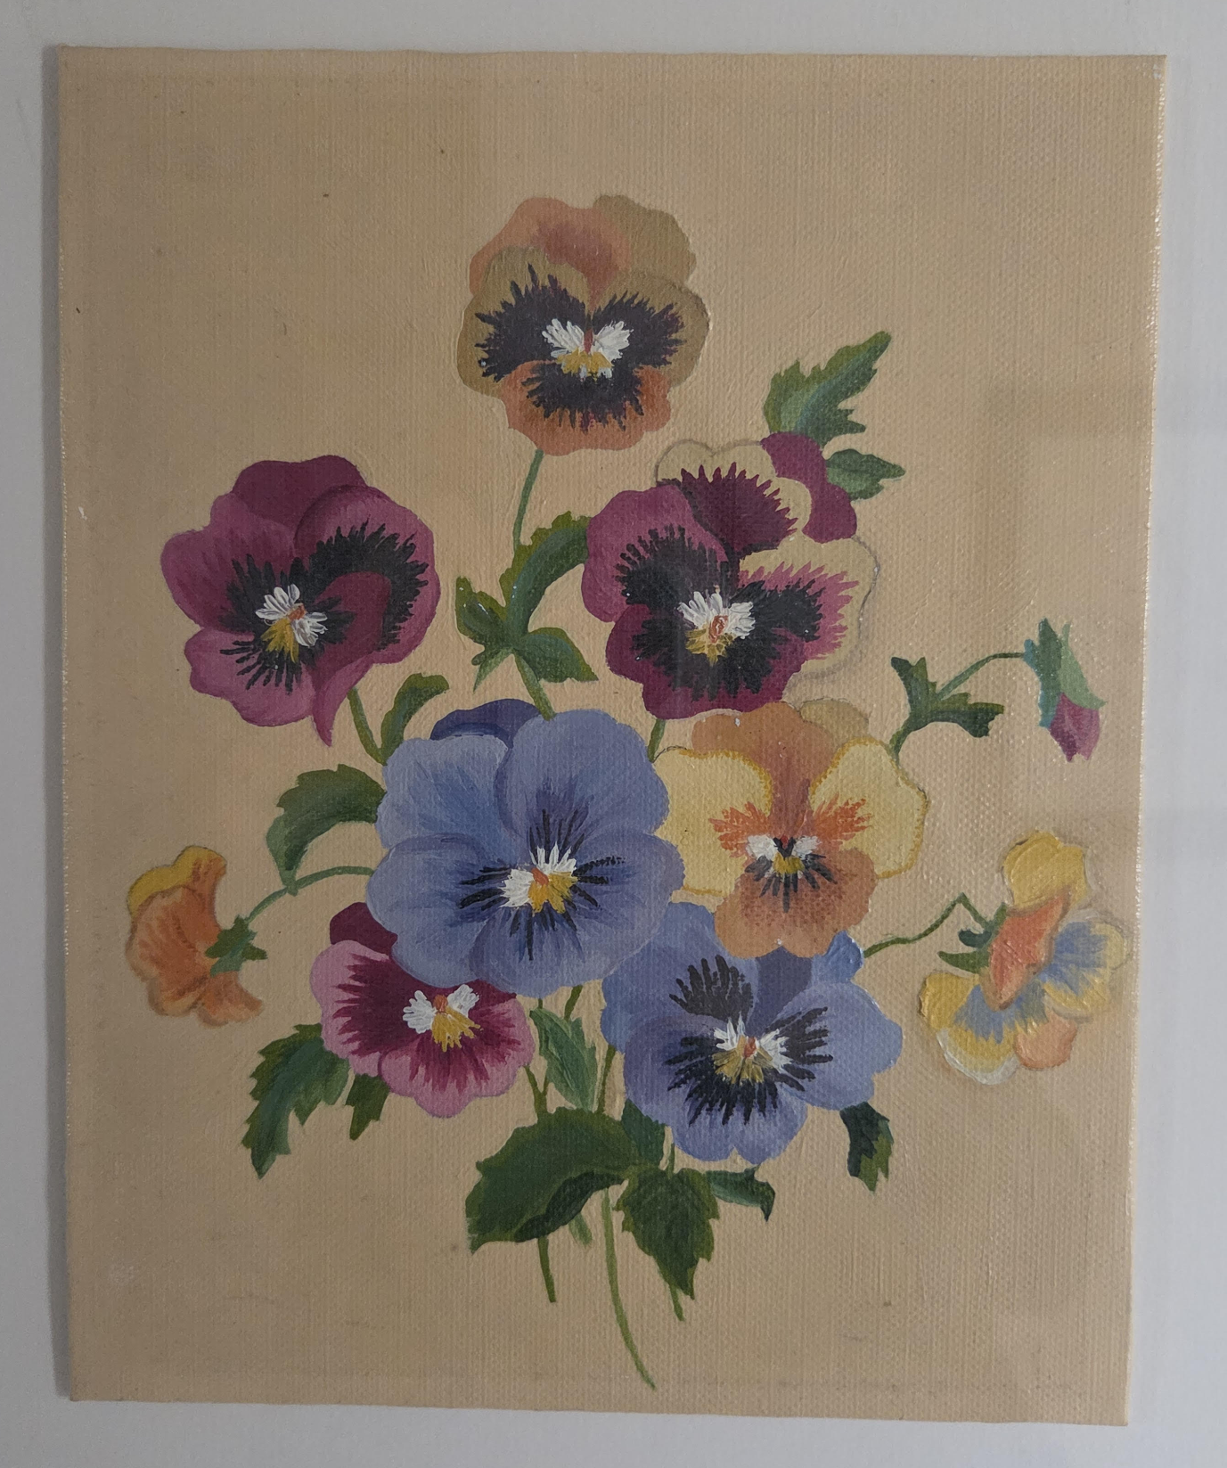
her pansies glow
on our wall
perennial
family photo
Notes:
[SLIDE 18]
She always loved flowers. Like Eliza Dolittle, she always dreamed of owning her own shop.
her pansies glow
on our wall
perennial

Slide 19
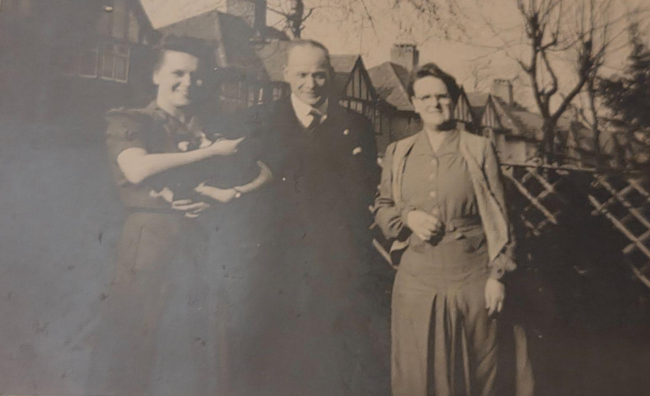
unplanned laundry day
the cat’s gone and had kittens
in our closet
family photo
Notes:
[SLIDE 19]
And Joyce loved cats, even when they weren’t always convenient.
unplanned laundry day
the cat’s gone and had kittens
in our closet

Slide 20
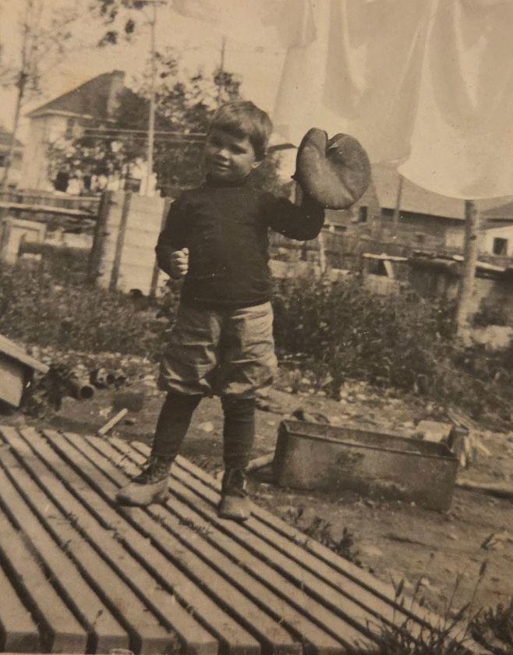
dad distracted
i wait after the inning
to ask my question
family photo
Notes:
[SLIDE 20]
Now, let’s look at some haiku I’ve written about Stan.
He played baseball and basketball as a boy, and remained a fan all of his life, regularly listening to games on the radio/
dad distracted
i wait to the end of the inning
to ask my question

Slide 21
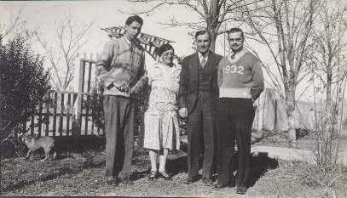
his dying breaths
i sneak away
for a smoke
family photo
Notes:
[SLIDE 21]
Tragically, his younger brother Karl died at the age of 20 from lung disease, a victim of Japan’s tuberculosis epidemic.
his dying breaths
i sneak away
for a smoke

Slide 22
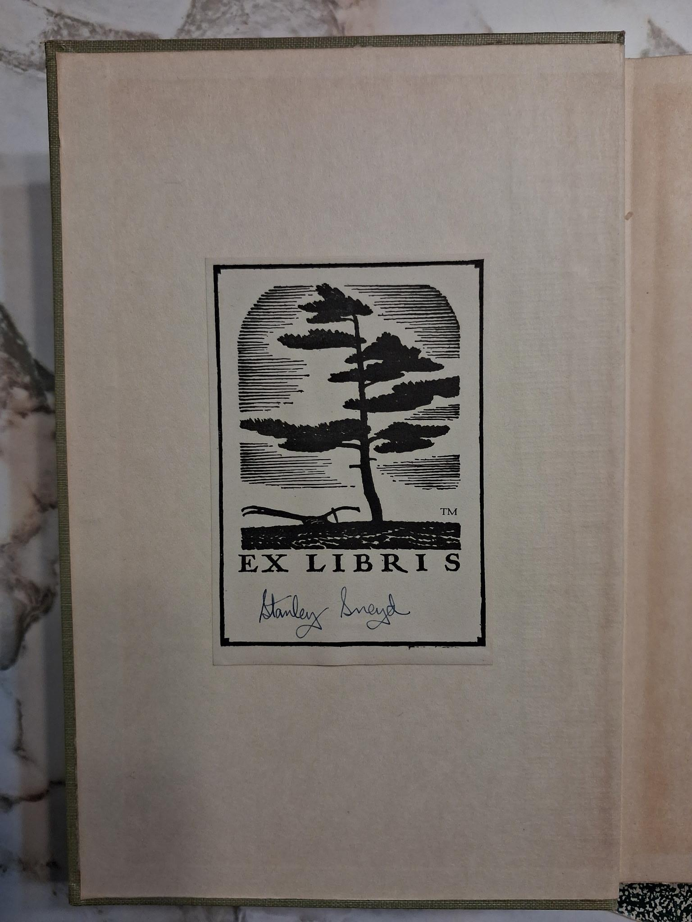
yellowed leaves
his bookplate still pasted
to the endpaper
a well-thumbed pile
of National Geographics
re-living his childhood
family photo
Notes:
[SLIDE 22]
He was an avid reader and we still have a number of his books…and magazines
yellowed leaves
his bookplate still pasted
to the endpaper
a well-thumbed pile
of National Geographics
reliving his childhood

Slide 23

party at the in-laws
an unlikely bond
over Beethoven
Angel Records, 1961
Notes:
[SLIDE 23]
He also loved classical music and would gladly talk about his favourite recordings with other fans.
party at the in-laws
an unlikely bond
over Beethoven

Slide 24
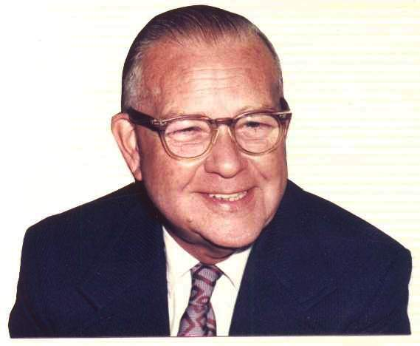
eyes adjusting to
the latest glasses…
my birthright
family photo
Notes:
[SLIDE 24]
Stan always had poor eyesight, culminating in cataract surgery that forced him to stay in bed for weeks and to wear coke-bottle lenses afterwards. Sadly, this poem could also be about my dad, my brother, and me
eyes adjusting to
the latest glasses…
my birthright

Slide 25
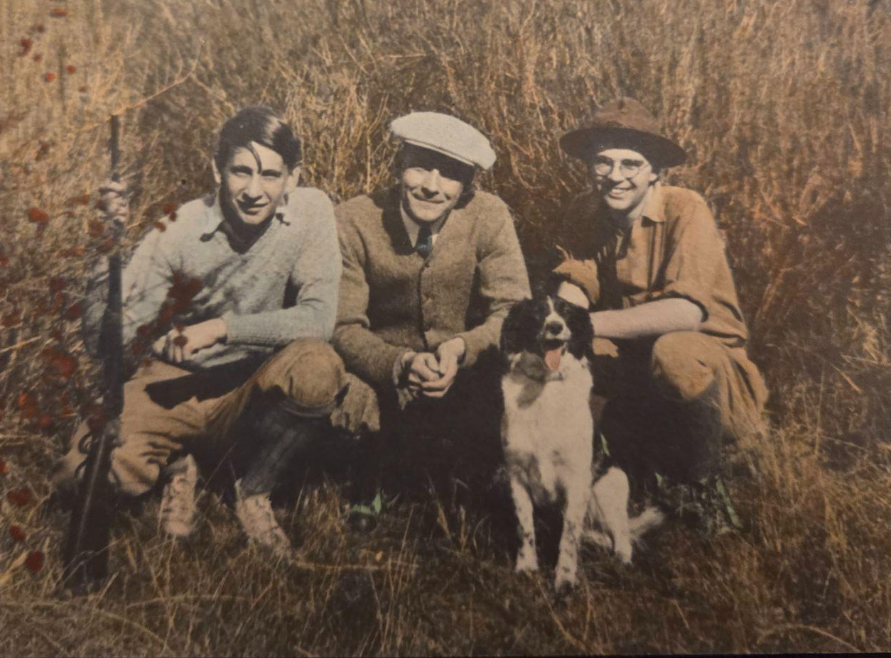
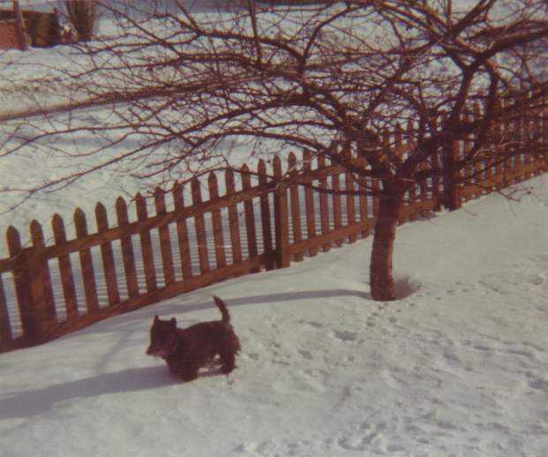
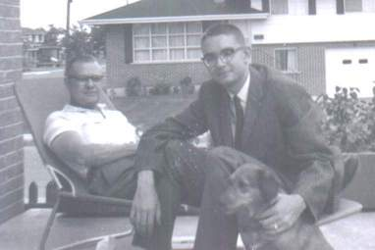
he plays catch
with the terrier in the yard
their favourite memory
family photos
Notes:
[SLIDE 25]
He loved dogs, so much so that the family asked for donations to the Humane Society when he died.
he plays catch
with the terrier in the yard
their favourite memory

Slide 26
haiga
.... .- .. --. .-
Notes:
[SLIDE 26]
As I began to write more and more poems for this project, I realized that I began to think in other styles, so I started to experiment with other styles, that is, haiga, split sequences, haibun, and renku, so I started to experiment. This still allowed me to retain the idea of “telegrams from the past”, but with the ability to add more context or to expand beyond the immediate by linking moments together.

Slide 27

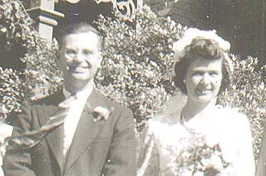
family photos
Notes:
[SLIDE 27]
I composed this haiga last July 4th on the 80th anniversary of Stan and Mildred’s wedding day. I was inspired by the photo on the right. I chose the oak tree for the haiga because it’s the traditional gift. eighty years on
skies as sunny as
wedding day smiles
I haven’t done any other haiga in relation to this project, but it’s something I’m certainly considering!

Slide 28
split sequences
... .--. .-.. .. - / ... . --.- ..- . -. -.-. . ...
Notes:
[SLIDE 28]
Let’s move on to a couple of split sequences I wrote. I think many here know what a split sequence is, but just to remind you, it’s a form created by Peter Jastermsky where you take a haiku, split the three lines apart, and then put a haiku between each of the lines.
The first split sequence I wrote was about Stan’s travels between North America and Japan. Based on what I’ve been able to find, I estimate that he crossed the Pacific six times between the age of 4 and 17. Right now, we know very little about those trips other than the dates and the names of the steamships they travelled on. I’m not even sure what class they travelled in. But, when I thought about these journeys, I thought about what it must have been like each time, and I realized that as Stan got older, each trip was probably quite different.

Slide 29
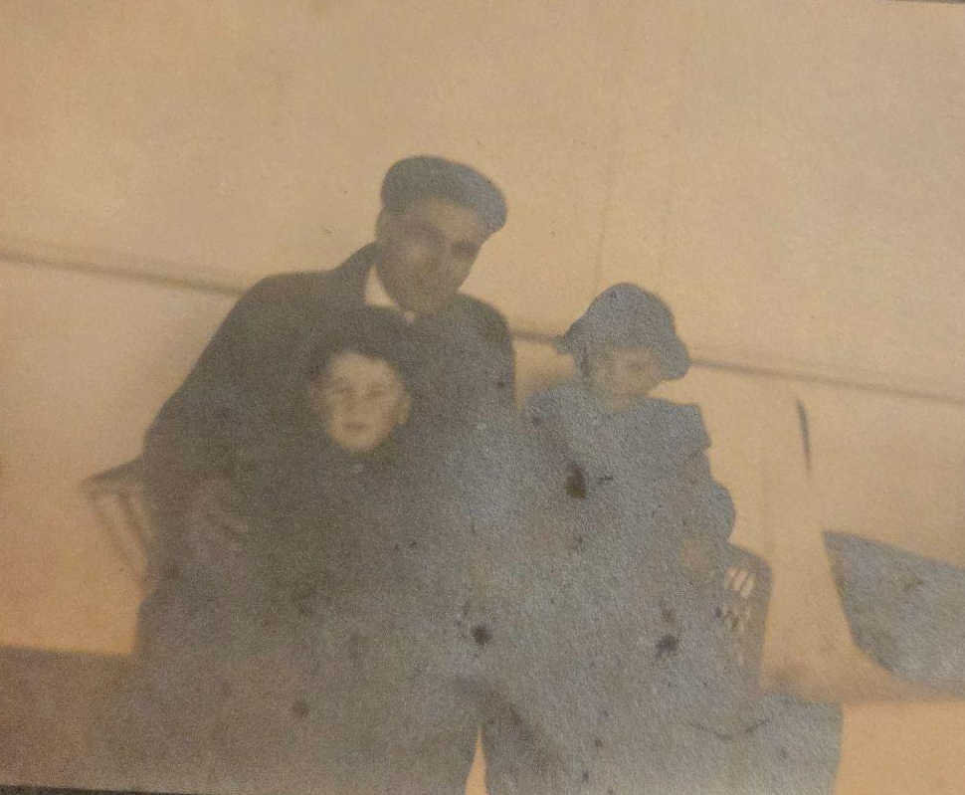
transpacific
the horizon rises
all bundled up
a snapshot with dad
in the deck chairs
and falls with the deck
away game
I stop my baseball from
rolling overboard
life changes
new route -
have I packed
enough to read?
- .-. .- -. ... .--. .- -.-. .. ..-. .. -.-.
family photo
Notes:
[SLIDE 29]
Transpacific
the horizon rises
all bundled up
a snapshot with dad
in the deck chairs
and falls with the deck
away game
I stop my baseball from
rolling overboard
life changes
new route -
have I packed
enough to read?

Slide 30
society items
... --- -.-. .. . - -.-- / .. - . -- ...
Notes:
[SLIDE 30]
The second sequence I wrote was inspired by several newsclippings where Joyce is featured. The first came from the local paper in Edgware, the suburb of London where she grew up. It’s about a painting competition she entered. The other two clippings come from the Hamilton Spectator. The first is about a burse, or special cloth case, that she made for a gathering of the Anglican Mother’s Union in Lambeth. And the final clipping is about the annual Balaclava ball held by Art’s post-war regiment. All of these pieces remind us of a time when newspapers were the authoritative source of information about community events, going into far greater detail than they ever would now.

Slide 31
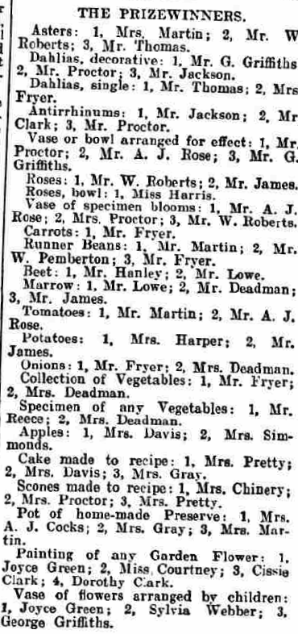
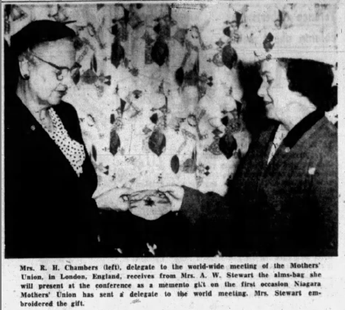
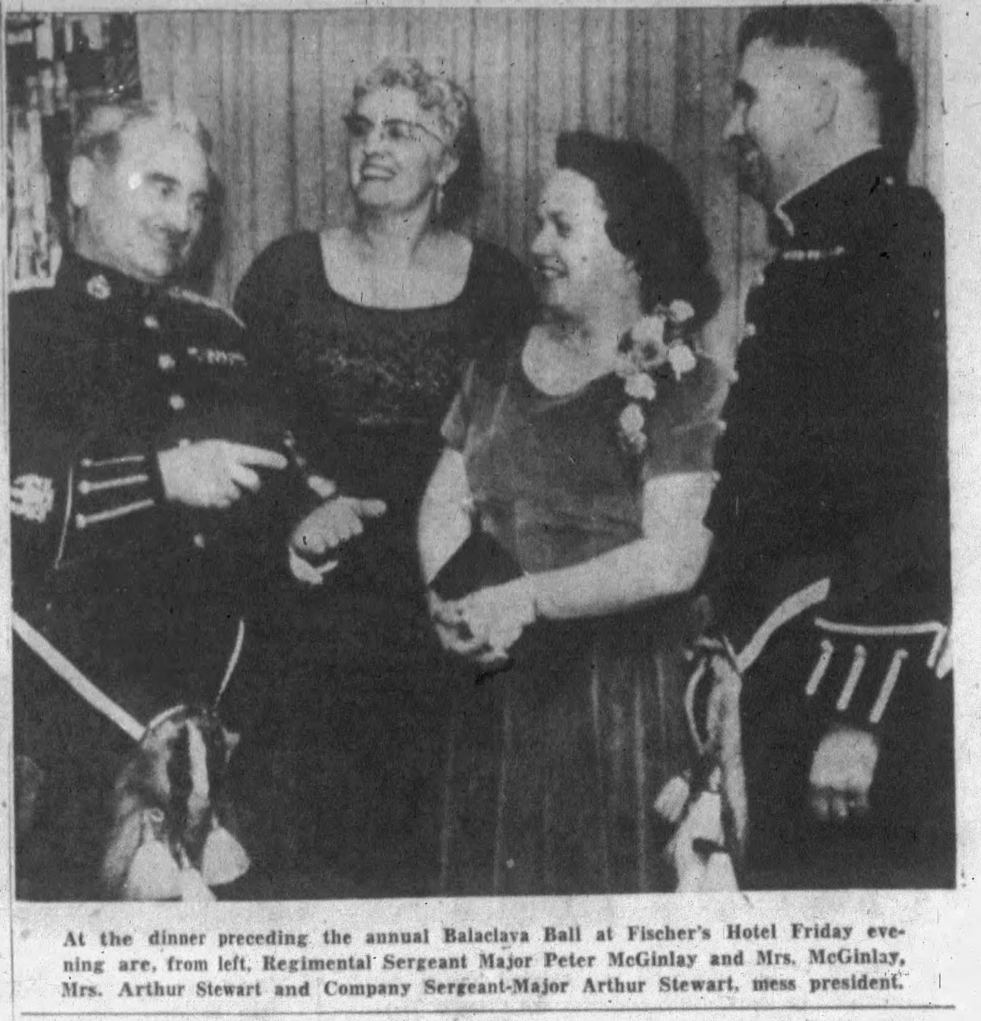
clipped from life
nicely framed
a prize-winning
vase of flowers
all those times you made
a sacred gift
i wish i could
present it in person
the news
right there in black and white
my corsage matches
your mess kit
www.newspapers.com
Notes:
[SLIDE 31]
clipped from life
nicely framed
a prize-winning
vase of flowers
all those times you made
a sacred gift
I wish i could
present it in person
the news
right there in black and white
my corsage matches
your mess kit

Slide 32
haibun
.... .- .. -... ..- -.
Notes:
[SLIDE 32]
When I was workshopping some of my haiku for this project with different groups, an occasional piece of feedback was “that would make a good haibun!” So, I took their advice and gave it a shot. I found that it was a good way of being able to incorporate more of the story while staying true to the style. So, let’s look at a couple of examples. This first one is relatively brief.

Slide 33
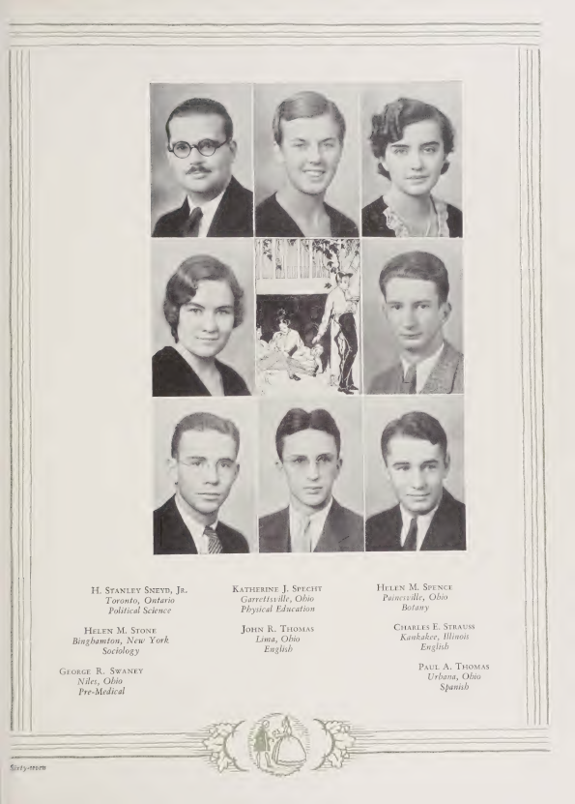
alma mater
.- .-.. -- .- / -- .- - . .-.
I scroll through digital copies of my grandfather’s Oberlin yearbooks from over 90 years ago. The scan isn’t a perfect one. Each image is slightly blurred but the text is clear. I find Grandpa’s graduation photo on page 67. His round glasses and dark mustache almost look drawn on, but I know from other images that both are real. His hair is slicked in the same style he wore until he died. He seems much older than his 23 years, but then, so do his classmates. The men’s suits and the women’s bobbed hair come straight out of a classic Hollywood film. I wonder what happened to them all.
worlds apart
grandpa’s major
the same as mine
“Hi-O-Hi”, Oberlin College, 1933
Notes:
[SLIDE 33]
Alma Mater
I scroll through digital copies of my grandfather’s Oberlin yearbooks from over 90 years ago. The scan isn’t perfect, each image is slightly blurred. I find Grandpa’s graduation photo on page 67. His round glasses and dark mustache almost look drawn on, but I know from other images that both are real. His hair is slicked in the same style he wore until he died. He seems much older than his 23 years, but then, so do his classmates. The men’s suits and the women’s bobbed hair come straight out of a classic Hollywood film. I wonder what happened to them all.
worlds apart
grandpa’s major
the same as mine

Slide 34
Ruthless
.-. ..- - .... .-.. . ... ...
Notes:
[SLIDE 34]
This second haibun is somewhat longer and so it probably pushes the limits of haibun a bit. Still it allowed me to share some family drama that unfurled over time. While Joyce and Art were very happily married, her cousin Ruth, who’d know Art for years, was not thrilled by the outcome.

Slide 35
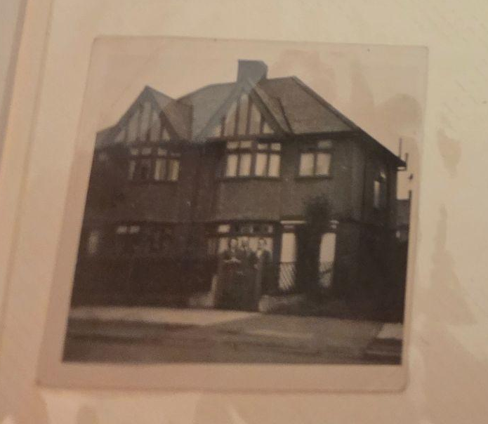
A July day in Edgware. My great-grandmother expects company from Canada. She’s splurged on some of her rationing coupons to offer as proper a tea as one can these days. The kettle whistles on the hob. Joyce arranges a vase of flowers for the table. A khaki figure passes by the front window. The doorbell rings.
her smile widens
as she opens the door
warm welcome
family photo
Notes:
[SLIDE 35]
Ruthless
A July day in Edgware. My great-grandmother expects company from Canada. She’s splurged on some of her rationing coupons to offer as proper a tea as one can these days. The kettle whistles on the hob. Joyce arranges a vase of flowers for the table. A khaki figure passes by the front window. The doorbell rings.
her smile widens
as she opens the door
warm welcome

Slide 36
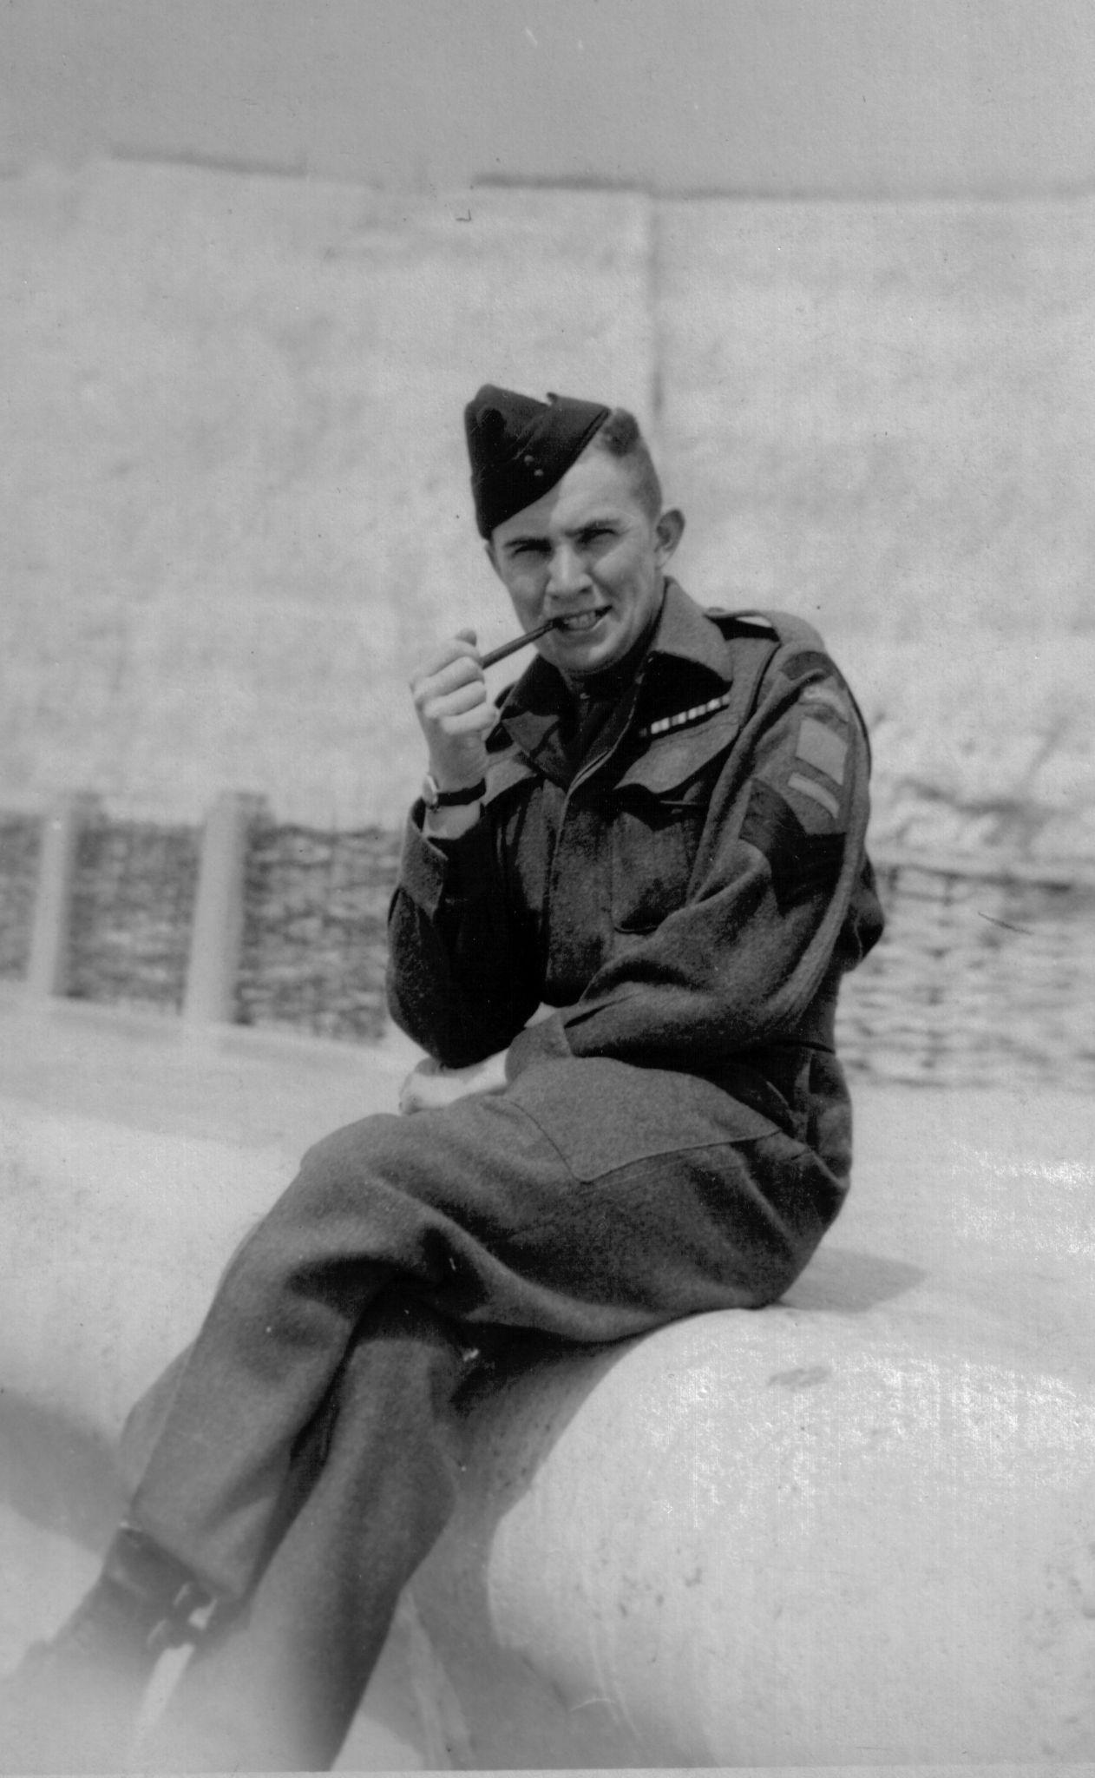
Art sits up in his army hospital bed, feeling a bit better. There’s another letter from Ruth in today’s mail. He opens it up and starts to read. It’s the same old gossip and telling him how much he’s missed at home. He knows courtesy demands he should reply, but his thoughts turn to Joyce instead. He fumbles for his tobacco pouch. Definitely a three-pipe problem.
“knitting him socks…”
she was never
in the running
family photo
Notes:
[SLIDE 36]
Art sits up in his army hospital bed, feeling a bit better. There’s another letter from Ruth in today’s mail. He opens it up and starts to read. It’s the same old gossip and telling him how much he’s missed at home. He knows courtesy demands he should reply, but his thoughts turn to Joyce instead. He fumbles for his tobacco pouch. Definitely a three-pipe problem.
“knitting him socks…”
she was never
in the running

Slide 37
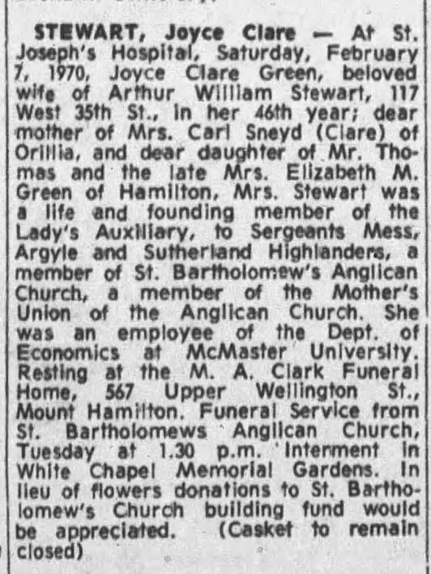
Ruth pays a “condolences” call. She tells my mother that Joyce stole Art from her all those years ago. Mum doesn’t know what to say. At 22 years old, who does, when confronted with old love?
overbrewed tea
her bitterness stains
the visit
www.newspapers.com
Notes:
[SLIDE 37]
Ruth pays a “condolences” call. She tells my mother that Joyce stole Art from her all those years ago. Mum doesn’t know what to say. At 22 years old, who does, when confronted with old love?
overbrewed tea
her bitterness stains
the visit

Slide 38
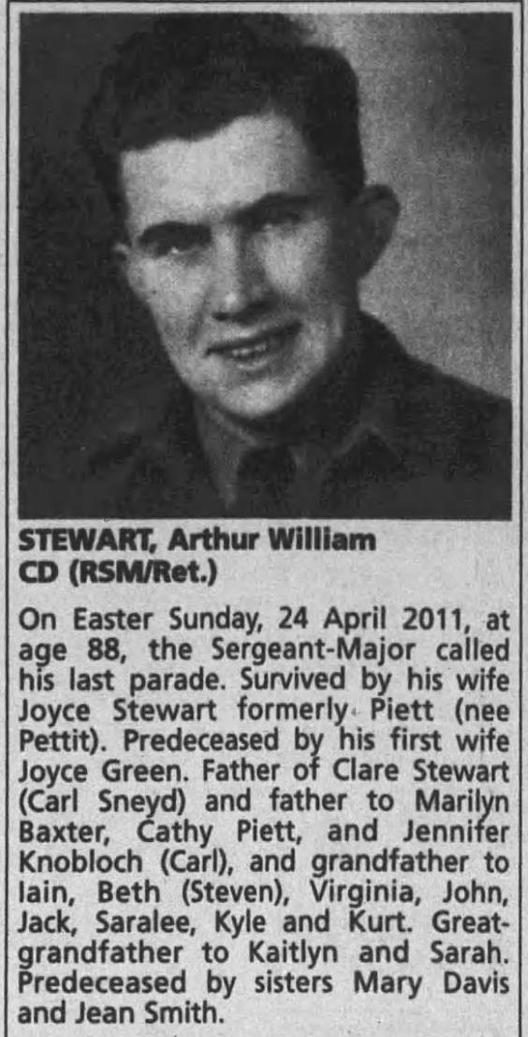
It’s years later and Ruth makes sure to attend Art’s memorial service. She seeks out my mother at the reception and subjects her to stories about her friendship with Grandpa when they were teens. Mum holds her tongue in the moment, but wonders if these things really happened.
long memory
the fish gets odder
with each telling
www.newspapers.com
Notes:
[SLIDE 38]
Years later Ruth seeks out my mother at Art’s memorial reception and subjects her to stories about her “friendship” with Art when they were teens. Mum holds her tongue in the moment, but wonders if these things really happened.
long memory
the fish gets odder
with each telling

Slide 39
renku
.-. . -. -.- ..-
Notes:
[SLIDE 39]
Finally, we have the renku-style sequences. I found that these were really useful for offering alternative perspectives when talking about an event. While the sequences are built around a specific theme much like a rengay, I found that I needed more space to work with, so I extended the poems to the renku style. While neither poem follows the renku pattern of “give me three lines on spring” that we all know, the first has 18 links, and the second has 36 links. You’ll also hear references to telegrams in each. Both of these poems are available in this pamphlet, so I won’t read them with repetition today. Please feel free to help yourself to a copy.
Transatlantic tells the story of Joyce’s journey from England to Canada as a war bride in September 1946. In this poem, the three-line poems recreate Joyce’s voyage and train journey, while the two-line poems reflect Art’s anxieties as he waits. I performed it at KaDo’s open mic at Ottawa’s Verse fest back in March.

Slide 40
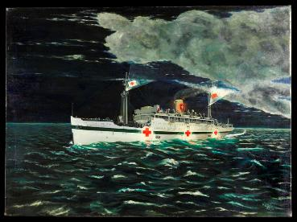
transatlantic
- .-. .- -. ... .- - .-.. .- -. - .. -.-.
life’s choices scattered
across the floor
half-full luggage
childhood gathers dust
in the attic
travel plans
snarled in red tape
saying farewell…again
a telegram arrives:
did not sail yet
picking up steam
green cliffs of home
in our wake
update by wire:
she’s on her way
Hospital Ship - Lady Nelson
Painted by Wilfred Leonard Whitern in 1944
Beaverbrook Collection of War Art
Notes:
[SLIDE 40]
Transatlantic
life’s choices scattered
across the floor
half-full luggage
childhood gathers dust
in the attic
travel plans
snarled in red tape
saying farewell…again
a telegram arrives:
did not sail yet
picking up steam
green cliffs of home
in our wake
update by wire:
she’s on her way

Slide 41
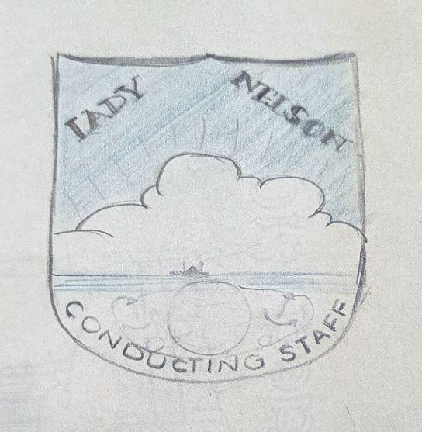
above decks
the wind blows away
our seasickness
a thunderstorm rolls
across the bay
appetite revived
my first white bread
as an adult
recommendations
for mother’s grocery list
designing ship’s crests
for onboard activities
a fresh pencil
twiddling the knobs
on the radio set
Family photo
Notes:
[SLIDE 41]
above decks
the wind blows away
our seasickness
a thunderstorm rolls
across the bay
appetite revived
my first white bread
as an adult
recommendations
for mother’s grocery list
designing ship’s crests
for onboard activities
a fresh pencil
twiddling the knobs
on the radio set

Slide 42
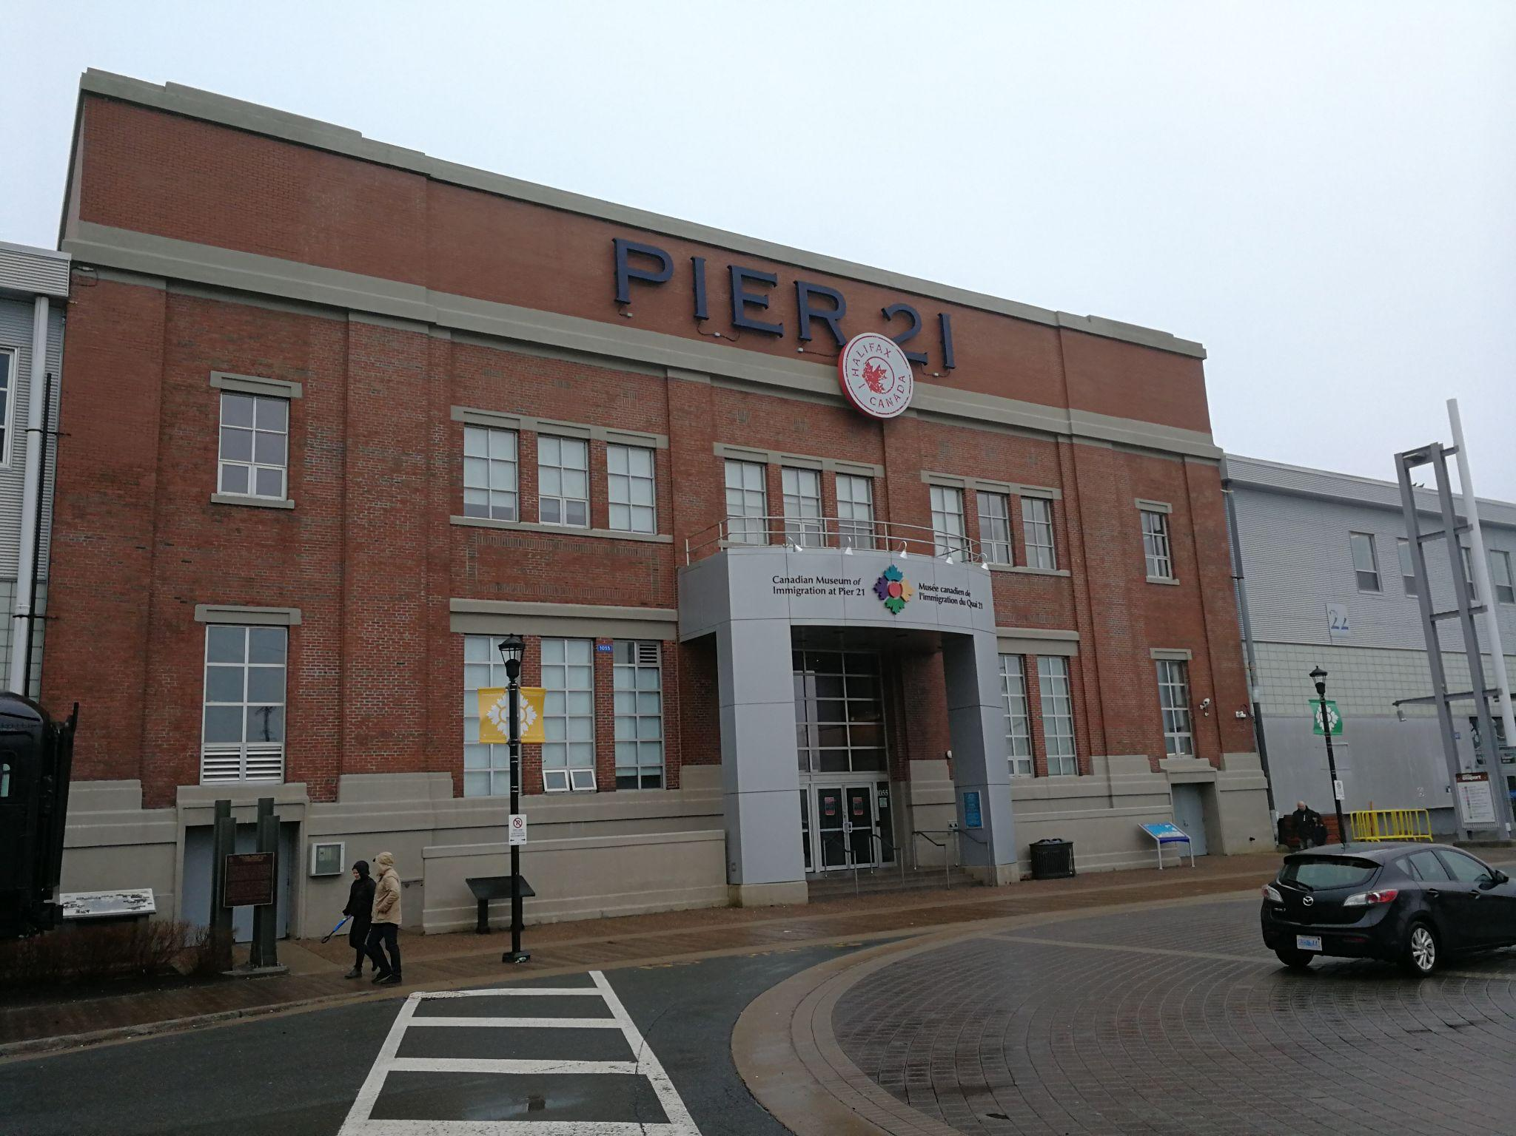
my cabinmate
spots land first -
a ducat for her thoughts
news from the east:
she arrives in two days
search for cottonwool
desperation grows with
each level crossing
a stop at the florist
to pick up roses
fresh lipstick
the train slows
to a stop
a final adjustment
to this new suit
Family photo
Notes:
[SLIDE 42]
my cabinmate
spots land first -
a ducat for her thoughts
news from the east:
she arrives in two days
search for cottonwool
desperation grows with
each level crossing
a stop at the florist
to pick up roses
fresh lipstick
the train slows
to a stop
a final adjustment
to this new suit

Slide 43
関東大地震 (Kantō daijishin)
-.- .- -. - --- ..- / -.. .- .. .--- .. ... .... .. -.
Notes:
[SLIDE 43]
This is the final poem that I’ll read for you today.
Kantō daijishin is about the Great Kantō Earthquake, which hit a vulnerable nation. There was a great deal of social unrest in Japan at the time and Prime Minister Katō had suddenly died in August, leaving Japan without an official government. The Sneyds were on their summer holidays in Karuizawa when the earthquake hit, but they didn’t escape the disaster. The three-line poems draw on existing accounts of the events in Yokohama and Tokyō, while the two-line poems imagine events in Karuizawa, mainly from Stan’s point of view. Because of the enormity of the event I went to 36 links on this poem, but even that barely scratches the surface. Also, perhaps not surprisingly, we don’t have any photos from this time, so I’ve pulled them from the internet.

Slide 44
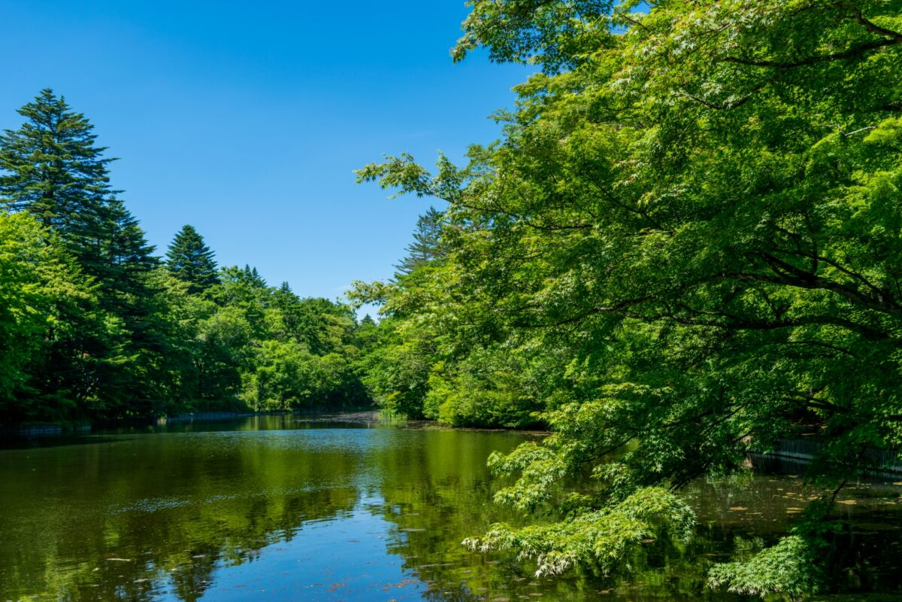
interregnum
a rudderless boat
drifts downstream
the last days
before the new term starts
a sudden drop
in Fuji’s lakes
scientists on edge
we skim pebbles
across Kumoba pond
unseasonal
a lull in the constant rasp
of crickets
mother calls us
in for lunch
https://karuizawa-kankokyokai.jp/en/spot/30500/
Notes:
[SLIDE 44]
interregnum
a rudderless boat
drifts downstream
the last days
before the new term starts
a sudden drop
in Fuji’s lakes
scientists on edge
we skim pebbles
across Kumoba pond
unseasonal
a lull in the constant rasp
of crickets
mother calls us
in for lunch

Slide 45
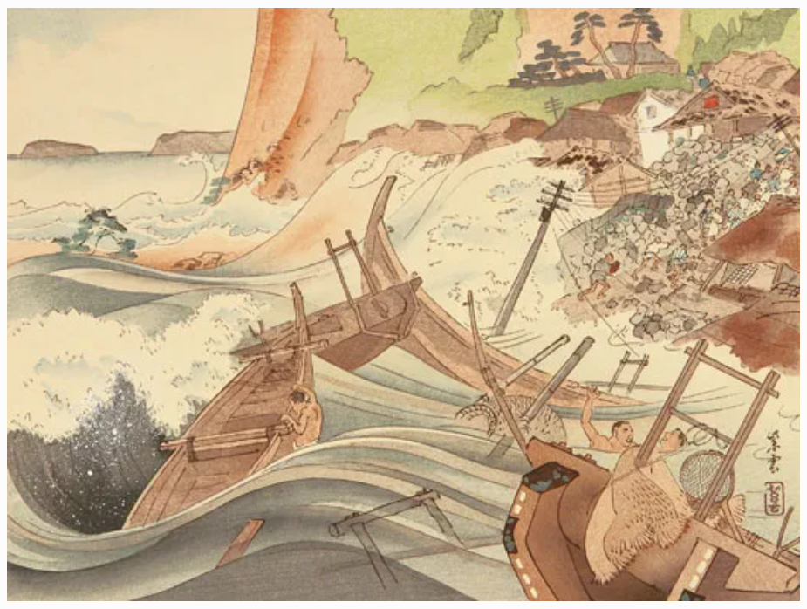
summer heat
smoke rising
from the hibachi
I sneak a slice
of fresh melon
initial hit
the catfish thrashes
in the pond
the trees quaver
outside the window
second wave
the entire world
shakes like jelly
I open my mouth
to ask…
https://www.smithsonianmag.com/history/the-great-japan-earthquake-of-1923-1764539/
Notes:
[SLIDE 45]
summer heat
smoke rising
from the hibachi
I sneak a slice
of fresh melon
initial hit
the catfish thrashes
in the pond
the trees quaver
outside the window
second wave
the entire world
shakes like jelly
I open my mouth
to ask…

Slide 46
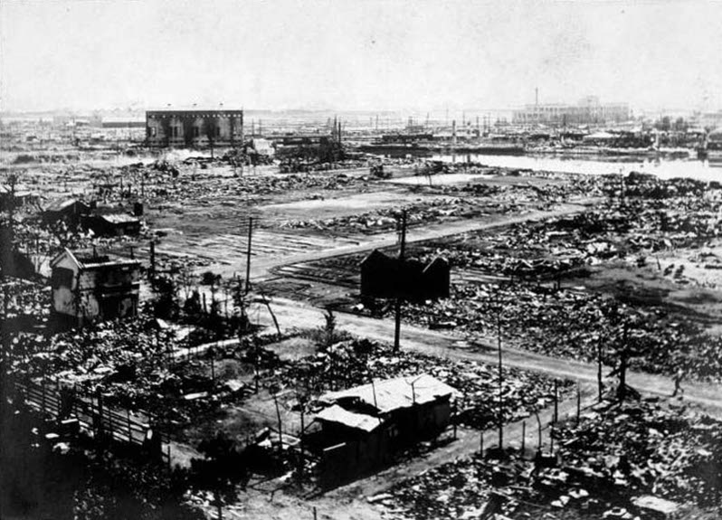
strike three
buildings crumple
in an instant
covering our heads
we dash outside
kamikaze blow
yellow dust everywhere
a copper sun
the road covered
with shattered roof tiles
fires gorge on
everything flammable
buyer’s remorse
unsure,
we linger outside
https://en.wikipedia.org/wiki/Great_Kant%C5%8D_Earthquake#/media/File:Kanto-daishinsai.jpg
Notes:
[SLIDE 46]
strike three
buildings crumple
in an instant
covering our heads
we dash outside
kamikaze blow
yellow dust everywhere
a copper sun
the road covered
with shattered roof tiles
fires gorge on
everything flammable
buyer’s remorse
unsure,
we linger outside

Slide 47

their refuge
becomes their crematorium
fire tornado
we shiver in
our summer whites
tsunami hits
the piles of corpses
continue to grow
dad’s telephone calls
go unanswered
cut in line
unspoken hope that
the telegrams get through
the men prepare to
head to town
Brown University Library/William Dana Reynolds
Notes:
[SLIDE 47]
their refuge
becomes their crematorium
fire tornado
we shiver in
our summer whites
tsunami hits
the piles of corpses
continue to grow
dad’s telephone calls
go unanswered
cut in line
unspoken hope that
the telegrams get through
the men prepare to
head to town

Slide 48

scorched serpents
the rail lines
lie twisted and torn
mother paces
in her room all night
relief on the road
women offer milk
from their ruined dairy
us older kids
give the little ones candy
mob rule
the fires of xenophobia
take hold
we wonder
about all of our friends
https://www.japantimes.co.jp/news/2023/08/31/japan/history/1923-tokyo-earthquake-anniversary/#gallery-5
Notes:
[SLIDE 48]
scorched serpents
the rail lines
lie twisted and torn
mother paces
in her room all night
relief on the road
women offer milk
from their ruined dairy
us older kids
give the little ones candy
mob rule
the fires of xenophobia
take hold
we wonder
about all of our friends

Slide 49

bluff called
the utter destruction
of everywhere
a telegram:
we’ve lost everything
millions rendered
homeless in a few hours
cruel nature
even the adults
don’t pay attention in church
Fuji rises above
the billows of smoke
the only constant
dad’s back,
he sure looks older
family photo
Notes:
[SLIDE 49]
bluff called
the utter destruction
of everywhere
a telegram:
we’ve lost everything
millions rendered
homeless in a few hours
cruel nature
even the adults
don’t pay attention in church
Fuji rises above
the billows of smoke
the only constant
dad’s back,
he sure looks older

Slide 50
Next steps
Notes:
[SLIDE 50]
While I do have other poems written, I don’t want to overstep my time limit, so I think we’ll leave it at that for today. If I look back at the questions I posed earlier in my presentation, I hope I’ve shown that haiku and its related forms can help you pull together family history in a unique, meaningful way. I do want to write more about Joyce and Stan’s lives, there’s so much to think about! My goal is to eventually turn this into a book, so I have a lot of work to do, both in writing and revising. But, I hope, that in the meantime you’ve enjoyed these “telegrams” from the past.

Slide 51
Thank you! Merci!
- .... .- -. -.- / -.-- --- ..- -.-.--
Notes:
[SLIDE 51]
Before I open up the floor for questions, I’d like to thank Hans and the other organizers of the Weekend for giving me the space to tell at least a bit of Joyce and Stan’s stories.
I must also thank the KaDo group and the Volery HSA mentorship group for their support in workshopping some of these poems. Their insight and editing abilities are always greatly appreciated.
I’m grateful to my parents for their interest in this project and for answering countless questions to the best of their ability. Thank you as well to my other relatives who were able to dig deep in their memories of Joyce and Stan and share what they could. And most of all to my husband Steve for his enduring support and suggestions. This project would not be possible without any of them.
Merci beaucoup, thank you very much.

